Slide 1
German-Japanese Workshop 2024, Mainz, Germany, Sep. 25, 2024
Lee-Yang-zero ratio
for critical-point searches
Masakiyo Kitazawa
(YITP, Kyoto)
In collab. with Tatsuya Wada, Kazuyuki Kanaya
Special thanks to S. Ejiri

Slide 2
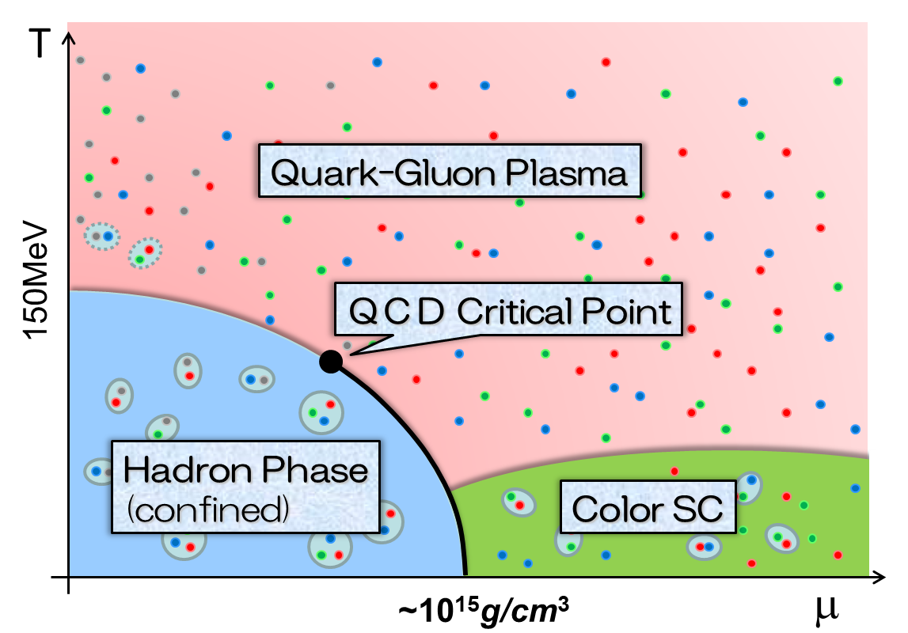
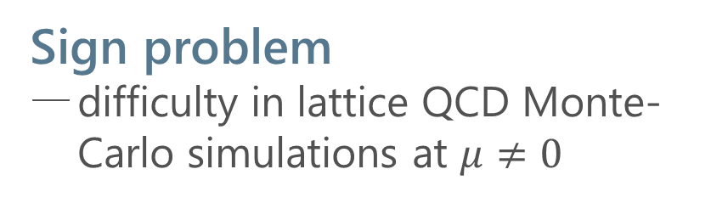
QCD Phase Diagram
Rich phase structure in QCD
QCD critical point(s)
color superconductivity
Sign problem
difficulty in lattice QCD Monte-Carlo simulations at $μ≠0$
Various approaches
Taylor expansion method
Imaginary chem. pot.
Complex Langevin
Lifschetz thimble
Lee-Yang edge singularity
…

Slide 3

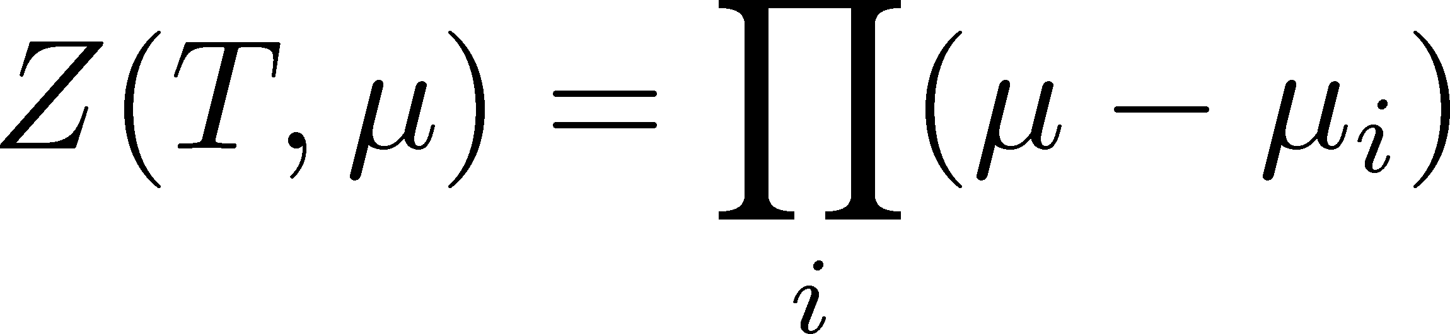




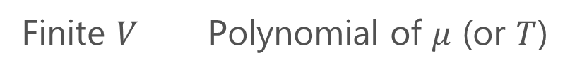
Lee-Yang Zeros
Yang, Lee; Lee, Yang (’52)
Partition Function
Finite $V$ Polynomial of $μ$ (or $T$)
zeros on the complex plane
=Lee-Yang Zeros

Slide 4


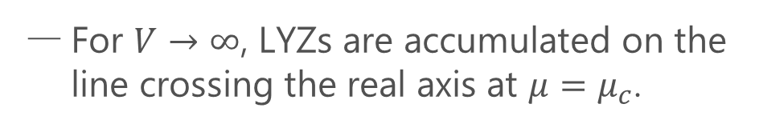

Lee-Yang Zeros
Yang, Lee; Lee, Yang (’52)
Partition Function
Phase Transition & LYZ
Finite $V$ Polynomial of $μ$ (or $T$)
First-order transition
at $μ=μ_{c}$
For $V→∞$, LYZs are accumulated on the line crossing the real axis at $μ=μ_{c}$.
zeros on the complex plane
=Lee-Yang Zeros

Slide 5

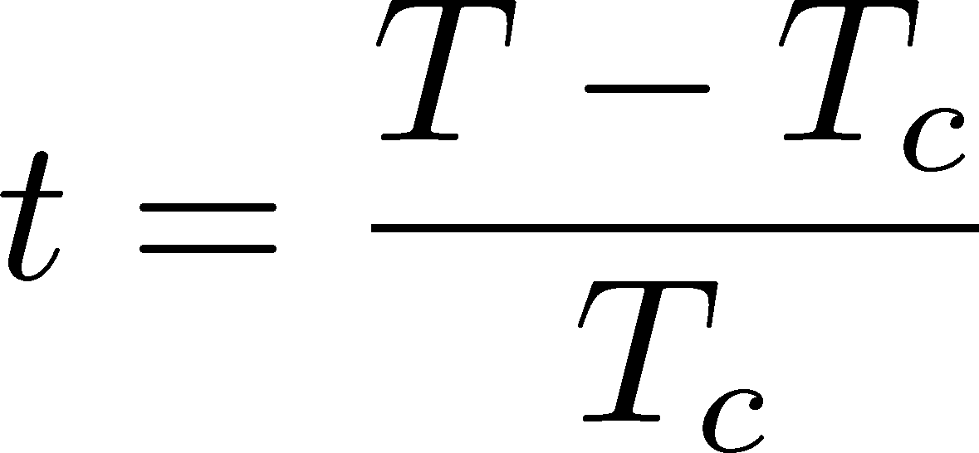

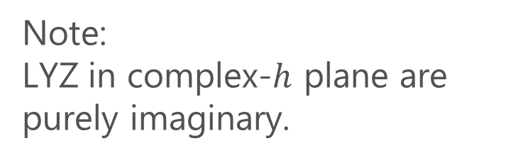

LYZ around a Critical Point in Ising Model
1st-transition
singularity on the real $h$ axis
Crossover
no singularity on the real axis
Note:
LYZ in complex-$h$ plane are purely imaginary.
Lee-Yang, 1952

Slide 6
LYZ around a Critical Point in Ising Model
1st-transition
singularity on the real $h$ axis
Crossover
no singularity on the real axis
Note:
LYZ in complex-$h$ plane are purely imaginary.
Lee-Yang, 1952

Slide 7


LYZ around a Critical Point in Ising Model
$$h_{I}\sim t^{βδ}$$
1st-transition
singularity on the real $h$ axis
Crossover
no singularity on the real axis
LY edge singularity
Starting from the CP
Its behavior is governed by the the scaling function.
$$h_{I}\sim t^{βδ}$$

Slide 8
LYZ around a Critical Point in Ising Model
$$h_{I}\sim t^{βδ}$$
1st-transition
singularity on the real $h$ axis
Crossover
no singularity on the real axis
LY edge singularity
Starting from the CP
Its behavior is governed by the the scaling function.
$$h_{I}\sim t^{βδ}$$

Slide 9

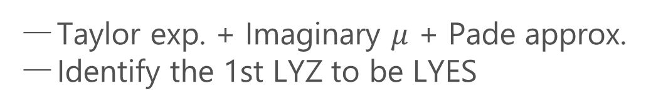
Recent Progress in LYZ/LYES and Lattice
Analytic Structure
Scaling functions, FRG, …
An, Mesterhazy, Stephanov (’16)
Johnson, Rennecke, Skokov (’23)
Karsch, Schmidt, Singh (‘23)
…
Locating QCD-CP at $μ≠0$ on the lattice?
Clarke+, arXiv:2405.10196
Alexander+ Lattice2024
Taylor exp. + Imaginary $μ$ + Pade approx.
Identify the 1st LYZ to be LYES

Slide 10
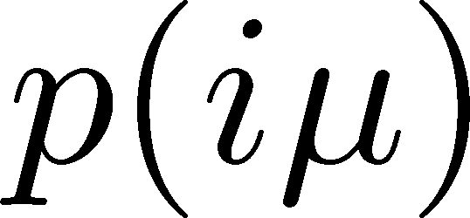
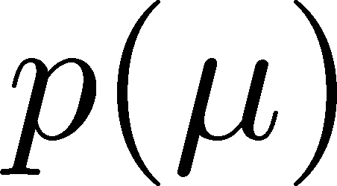
QCD-CP Search with Lee-Yang Zeros
D. Clarke+
2405.10196 [hep-lat]
Imaginary chem. pot.
Lee-Yang zero
LYZ
See also, Alexander+ Lattice2024
analytic continuation via Pade approx.

Slide 11

Purpose of This Study
$$h_{I}\sim t^{βδ}$$
On finite volume,
1st LYZ $≠$ LYES
Study finite-volume effects on the LYZ near CP.
Propose a new method to explore the CP via LYZ.

Slide 12


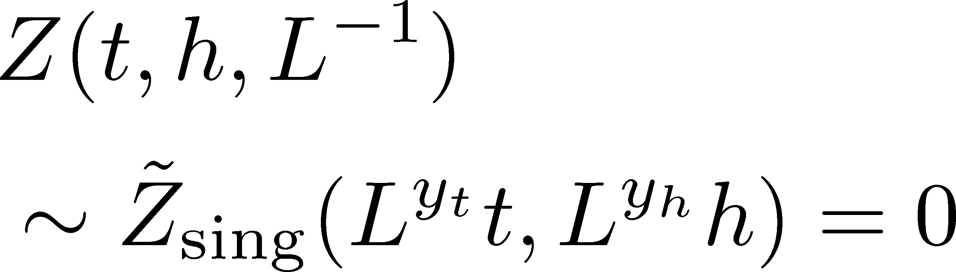
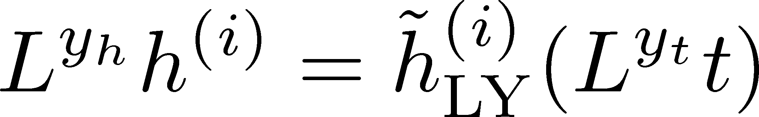
Finite-Size Scaling
Scaling Hypothesis
LYZ in the scaling region on finite volume

Slide 13
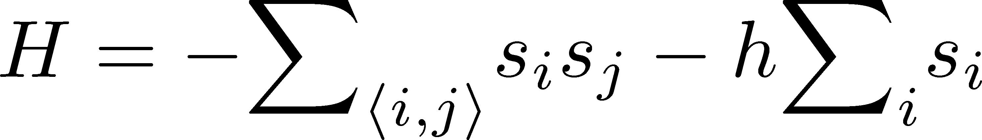
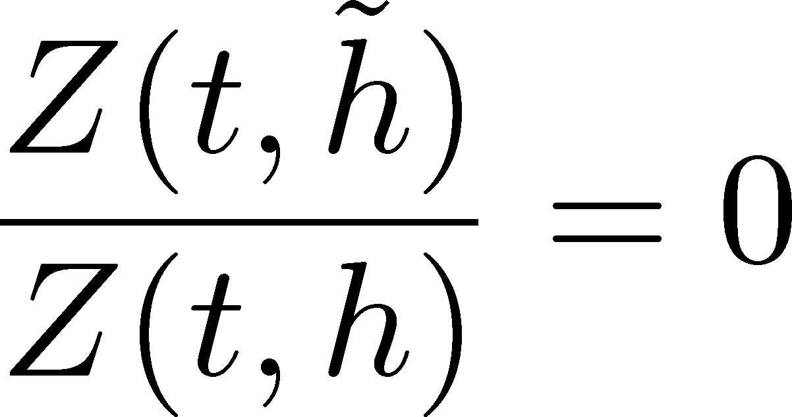
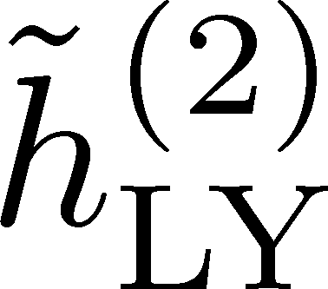

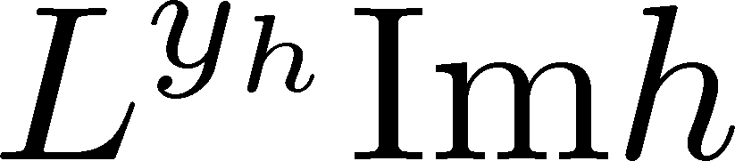
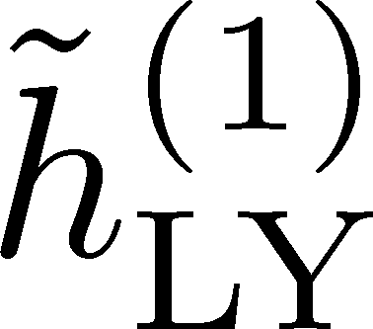
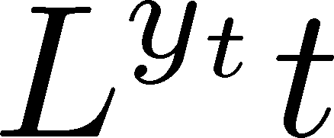

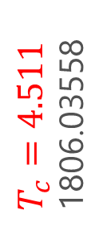
LYZ in 3d-Ising Model
LYZ
Monte-Carlo + reweighting
1st & 2nd LYZ
Rescaled
rescale
$T_{c}=4.511$
1806.03558
Preliminary
Preliminary
LYZ is away from the real axis at the CP on finite $L$.

Slide 14
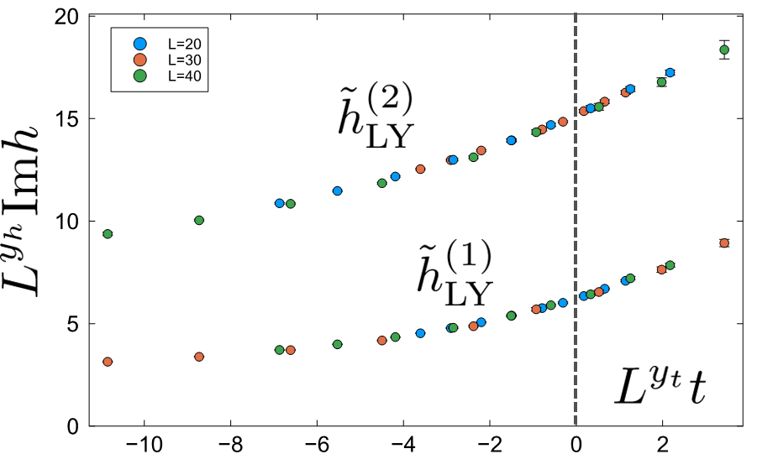

Where is QCD Critical Point?
Ising model
LYZ in QCD
Clarke+, arXiv:2405.10196
CP around here?

Slide 15
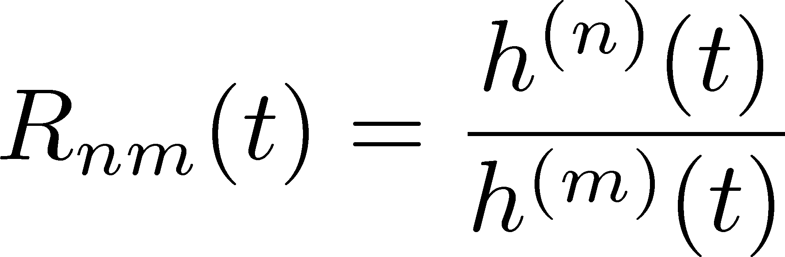
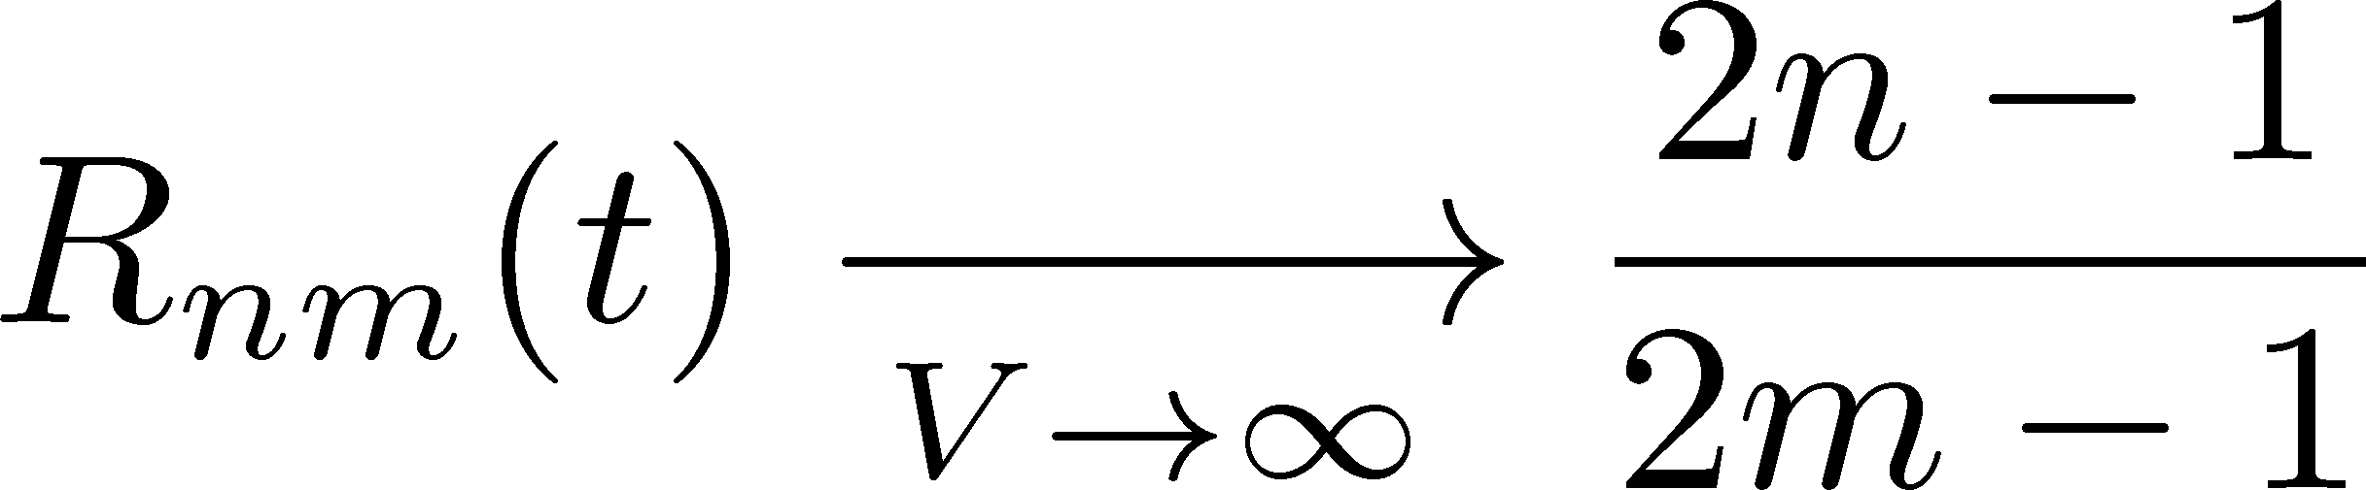
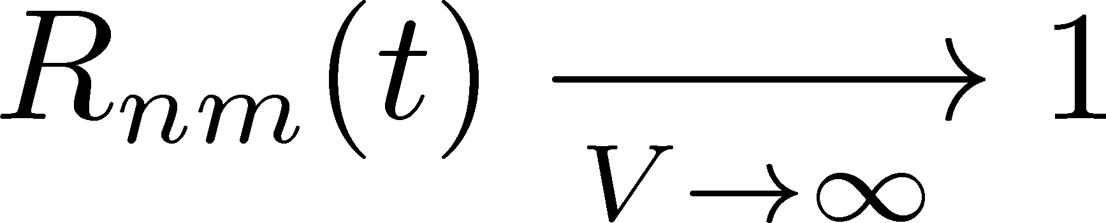
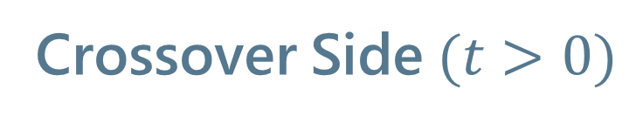
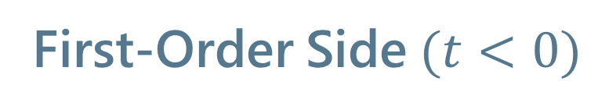
Lee-Yang Zero Ratio
First-Order Side$(t<0)$
Crossover Side$(t>0)$

Slide 16
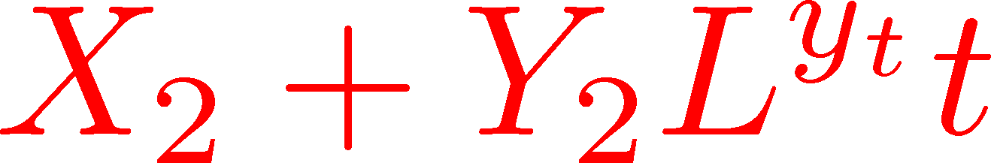
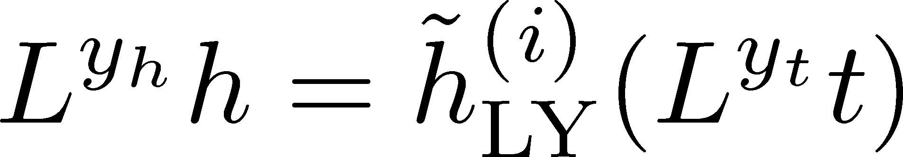
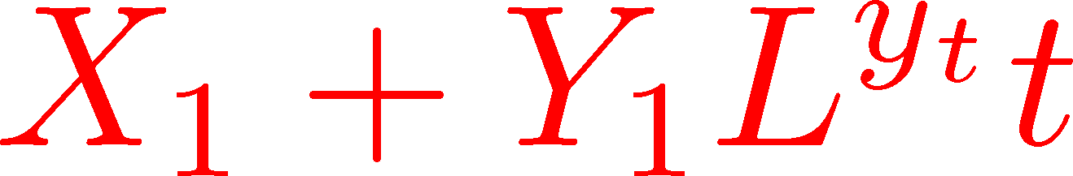
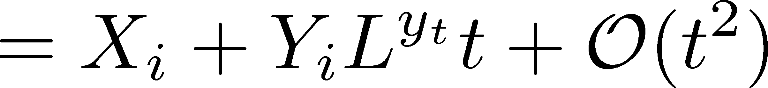
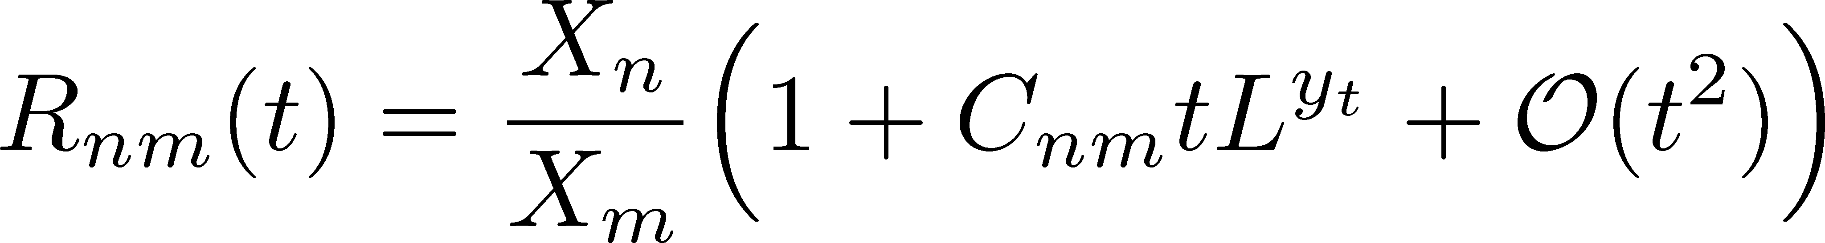
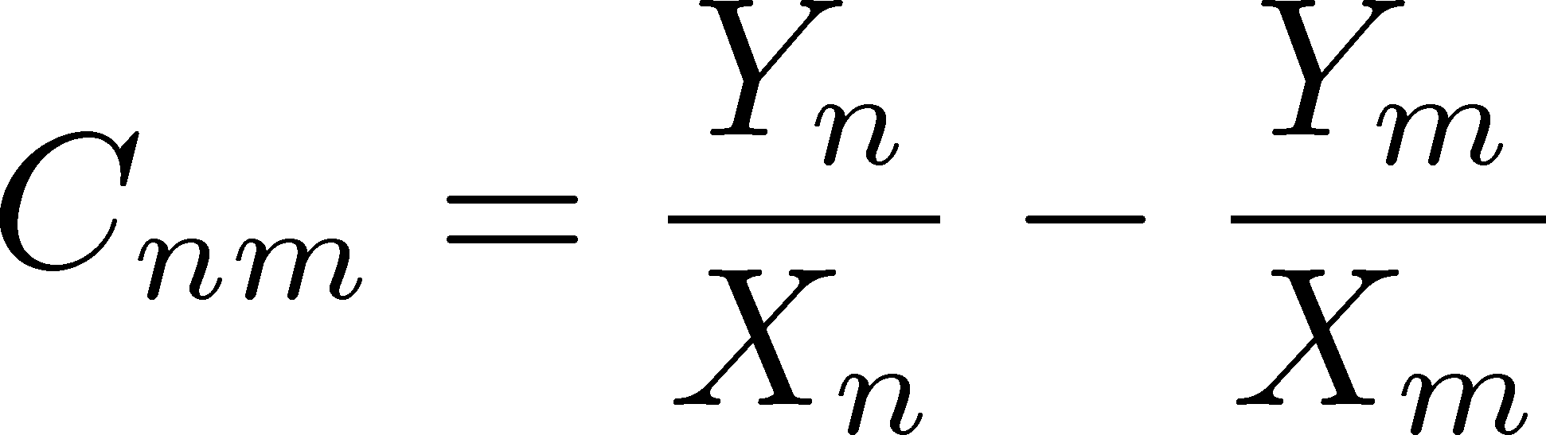

Lee-Yang Zero Ratio
Linear Approx. at $t=0$

Slide 17
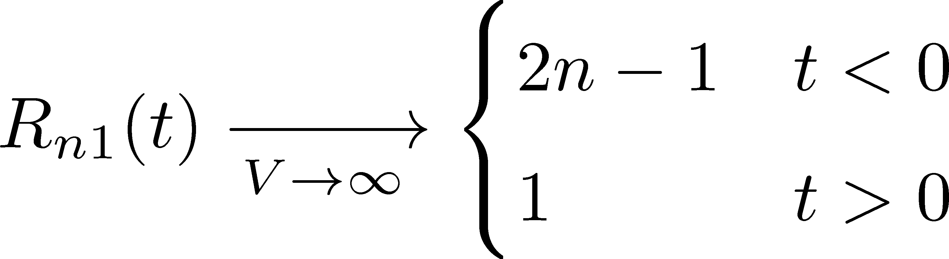
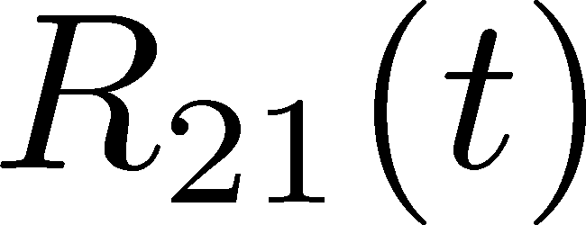

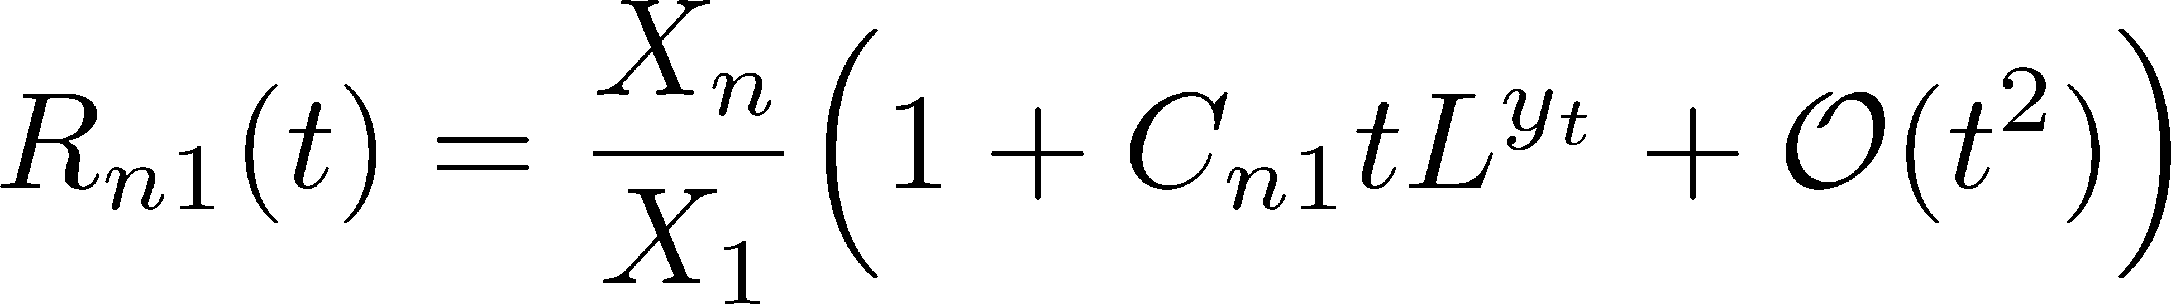
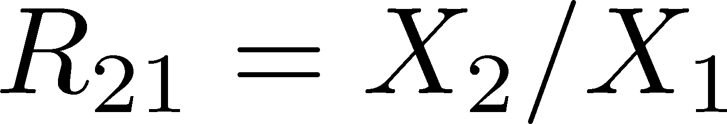


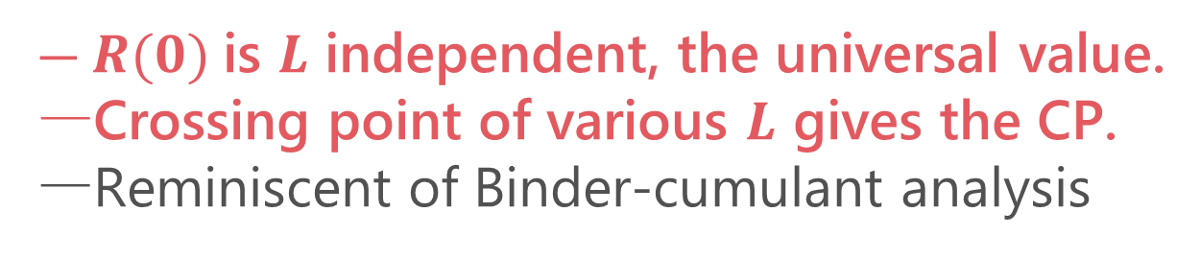
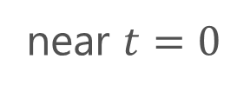
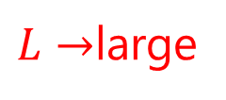
LYZ Ratio
(1st order)
(crossover)
crossing
$L→$large
near $t=0$
$R(0)$is $L$ independent, the universal value.
Crossing point of various $L$ gives the CP.
Reminiscent of Binder-cumulant analysis

Slide 18
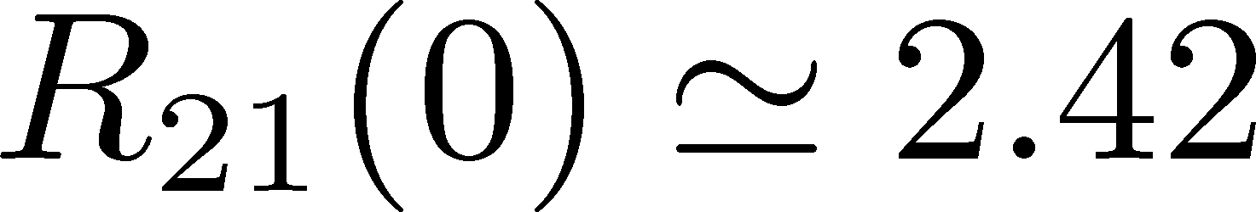
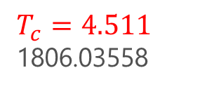
LYZ Ratio
Numerical Result in 3d-Ising
(1st order)
(crossover)
Preliminary
near $t=0$
$T_{c}=4.511$
1806.03558
$R(0)$is $L$ independent, the universal value.
Crossing point of various $L$ gives the CP.
Reminiscent of Binder-cumulant analysis

Slide 19


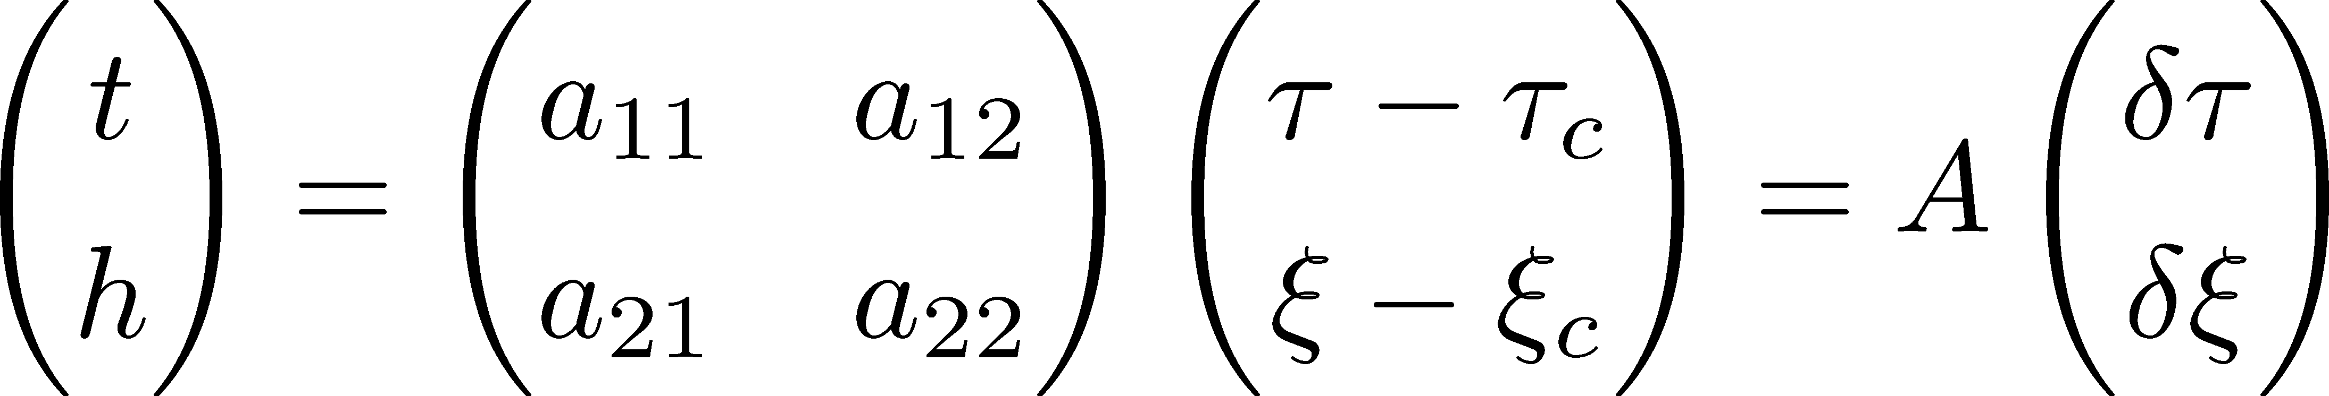

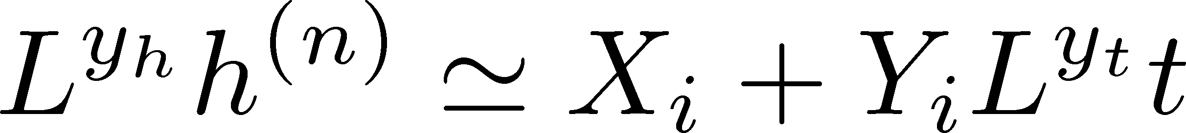


General CP
CP on a $τ−ξ$ plane
LYZ on the complex $ξ$ plane

Slide 20
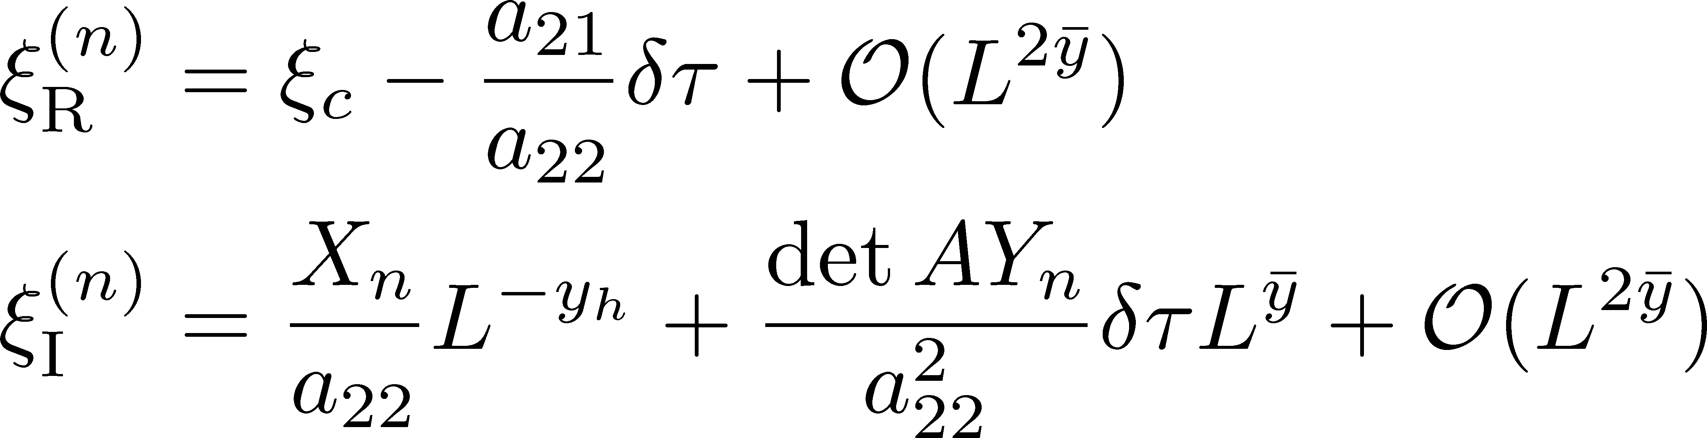
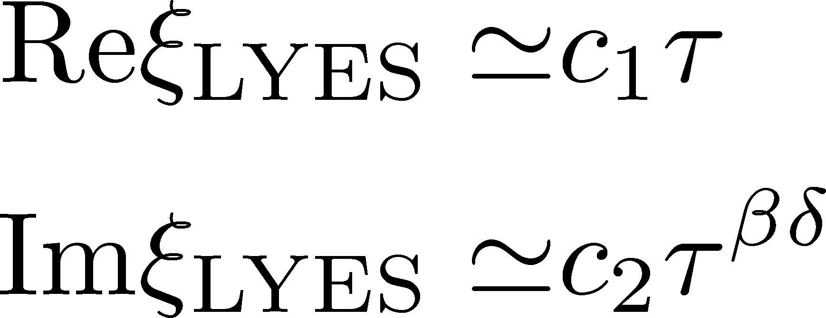

General CP
CP on a $τ−ξ$ plane
LYZ on the complex $ξ$ plane
$$L→∞$$
LY Edge Singularity
generalization
Stephanov, 2006

Slide 21

LYZ Ratio for General CP
LYZ Ratio
nonzero for $a_{12}≠0$

Slide 22
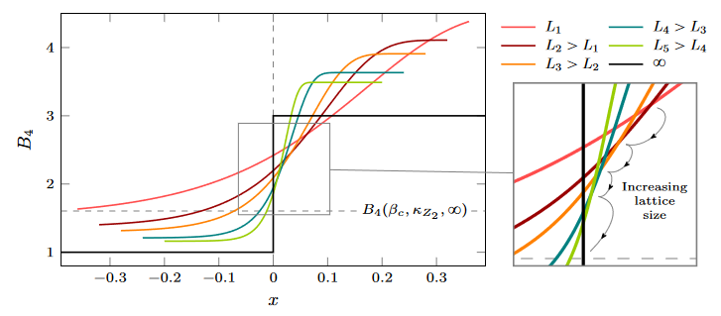

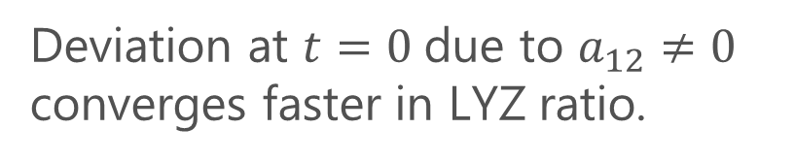
LYZ Ratio for General CP
LYZ Ratio
nonzero for $a_{12}≠0$
Binder cumulant
Jin+, PRD86, 2017
nonzero for $a_{12}≠0$
fig from
Cuteri+,
PRD (’21)
Deviation at $t=0$due to $a_{12}≠0$ converges faster in LYZ ratio.

Slide 23
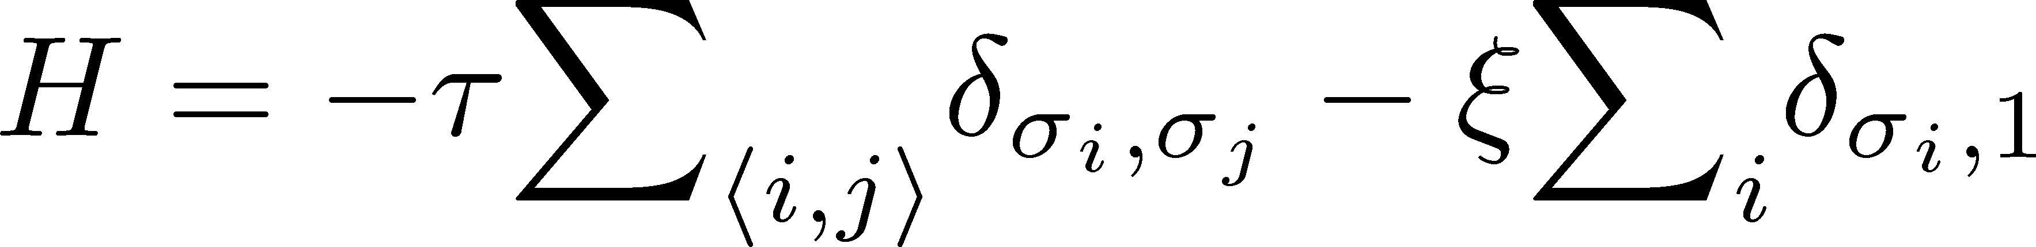
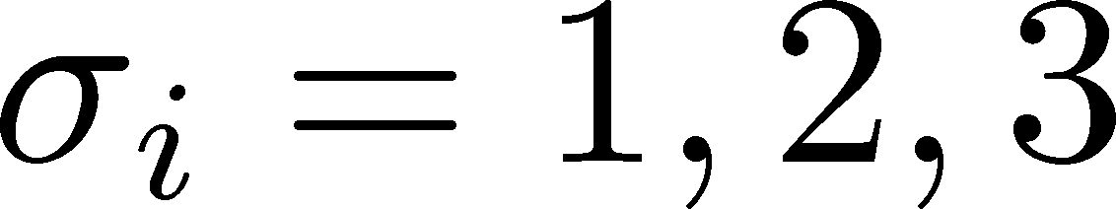
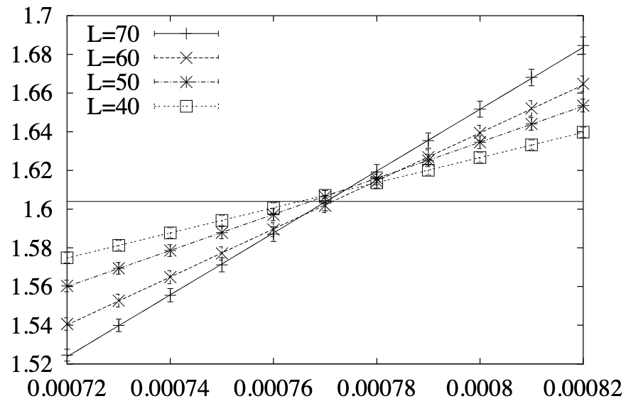
Numerical Analysis: 3d 3-State Potts Model
Monte-Carlo + reweighting
Phase Diagram
Binder-Cumulant Analysis
Z(2) CP
1st-order
Z(3)
Karsch, Stickan, 2000

Slide 24
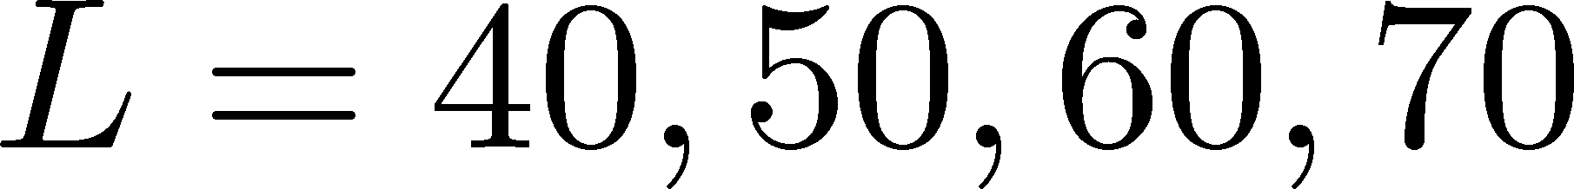





3d 3-State Potts Model: LYZ Ratio
Preliminary
consistent
$R_{n1}$ and $B_{4}$ give the same value of $τ_{c}$ within statistics.

Slide 25



3d 3-State Potts Model: LYZ Ratio
Preliminary

Slide 26

Summary
LYZ give us valuable information of phase transitions.
Their finite-size effects are non-negligible in typical numerical simulations.
We proposed the use of the ratio of LYZ for locating a CP.
Verification in 3d-Potts model.
Outlook
Mapping of Ising variables
Measurement of $R_{nm}(0)$ in Ising model
Question: Can lattice QCD find the 2nd LYZ??

Slide 27
backup

Slide 28
QCD-CP and LYZ

Slide 29

Using LYZ for the QCD-CP Search
Taylor expansion
LYZ
LYZ
Imaginary chem. pot.
Use of Pade approximation

Slide 30




CP in Heavy-Quark QCD
Columbia Plot
Phase Diagram
This study
critical point
CP in heavy-quark QCD
We study the LYZ around the HQ-QCD-CP.
$μ_{q}=0$ & large $m_{q}$
Easy to handle in lattice simulations!

Slide 31









Hopping-Parameter Expansion (HPE)
~ $1/m_{q}$ expansion
Kiyohara, MK, Ejiri, Kanaya, PRD(’21)
Ashikawa, MK, Ejiri, Kanaya, arXiv:2407.09156
Wilson Fermion
: hopping parameter
nonzero only for neighboring $(x,y)$
Hopping-Parameer Expansion
$n$th order terms in the HPE: closed trajectories of length $n$.

Slide 32




Higher-Order Terms in HPE
Kiyohara, MK, Ejiri, Kanaya, PRD(’21)
Ashikawa, MK, Ejiri, Kanaya, arXiv:2407.09156
Monte Carlo Simulation @ LO
heat bath & over relaxation with modified staple
$\hat{P}$: plaquette
$\hat{Ω}$: Polyakov loop
Numerical cost is almost the same as the pure YM!
NLO by Reweighting
Overlapping problem is well suppressed due to the LO confs.
Realize high statistical analysis

Slide 33






Binder Cumulant Analysis
$N_{t}=4$: Kiyohara, MK, Ejiri, Kanaya, PRD, 2021
$N_{t}=6$: Ashikawa, MK, Ejiri, Kanaya, arXiv:2407.09156
w/ Dynamical Fermions
Cuteri , Philipsen , Schön, Sciarra, ’21
One order smaller statistical errors on more than twice larger $LT$!
Precise determination of the location of the CP

Slide 34


LYZ Ratio
$N_{t}=4,$ HPE-NLO
Preliminary
Preliminary
Conistent with the Binder-cumulant analysis $β_{c}=5.68578(22)$.

