Slide 1





13–15 Oct 2026 | Helmholtz Institute Mainz (HIM)
Ideas for Nanoparticle Loading in Liquid Argon (LAr) Detectors
Thais Silva and Marcin Kuźniak
For the ARGO Collaboration

Slide 2
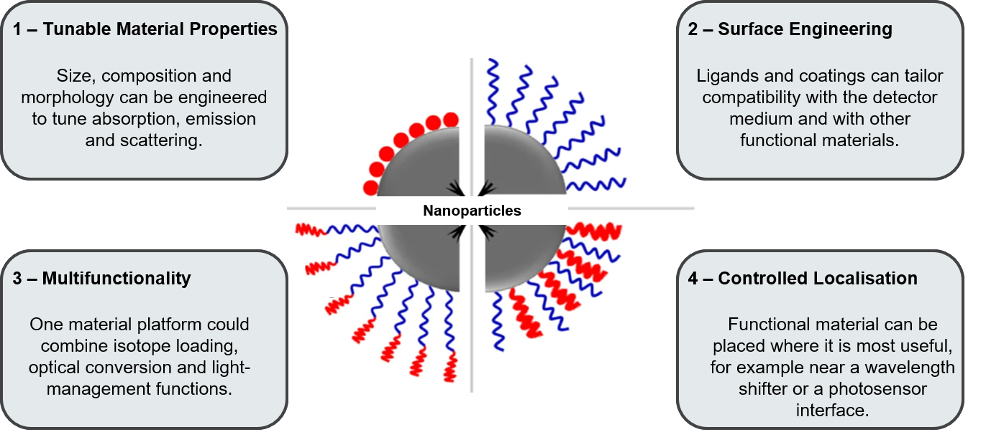
Why Nanoparticles for Particle Detectors?
Why consider nanoparticles at all for particle detectors?
2
Notes:
Before diving into the presentation, I would like to start with the broader question: why consider nanoparticles at all for particle detectors? Nanoparticles offer control over composition, size, surface chemistry, and localisation

Slide 3
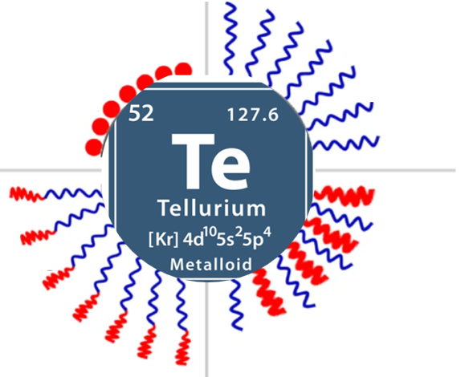
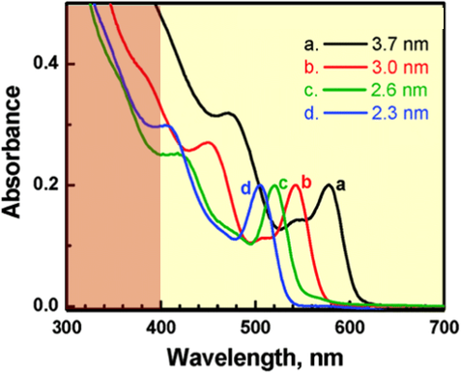
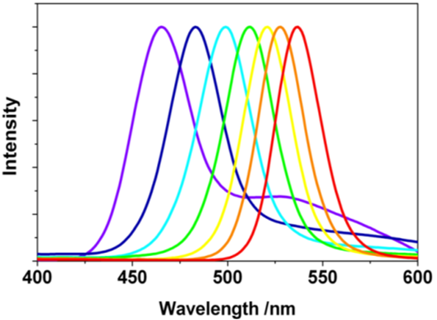


Tellurium Nanoparticles as a Case Study?
Property | Why it matters
¹³⁰Te abundance (34%) | No isotopic enrichment
High Qββ | Good candidate for 0νββ
High Te density | More isotope per volume
Quantum effects | Possible wavelength shifting
Nanoparticle form | Potential high loading with tunable optics
Qββ$=2.5 MeV$
¹³⁰Te$→130Xe+2e^{−}$
1. ¹³⁰Te carriers - Neutrinoless double beta decay isotope target.
2. Wavelength shifters.
3
Notes:
Neutrinoless double beta decay isotope target.

Slide 4

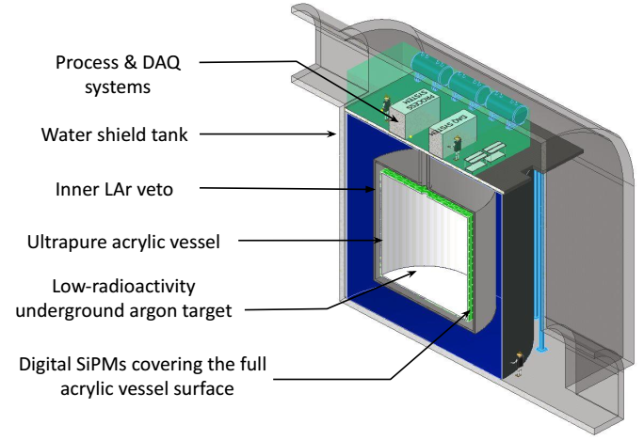
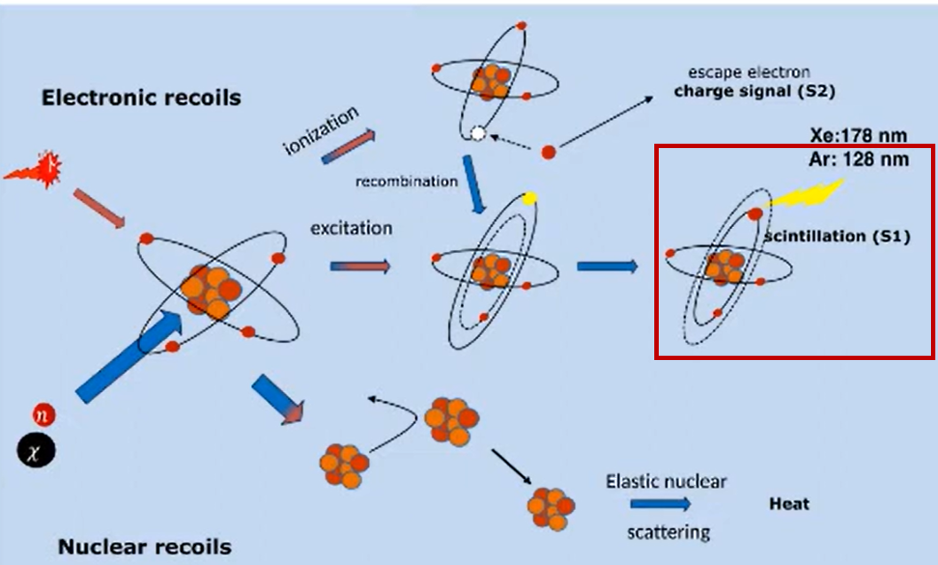

LAr Detectors – The Future ARGO Experiment
A major requirement for these experiments is the detection of the vacuum ultraviolet (VUV) LAr scintillation light with high efficiency (128 nm) in the conventional photodetectors.
The idea with Te nanoparticles is potentially:
$$128 nm→Te NPs→visible photon$$
The project is currently in the conceptual development and funding search phase.
4
Notes:
LAr scintillation occurs at 128 nm, while photosensors need longer wavelengths. 400-tonne total

Slide 5
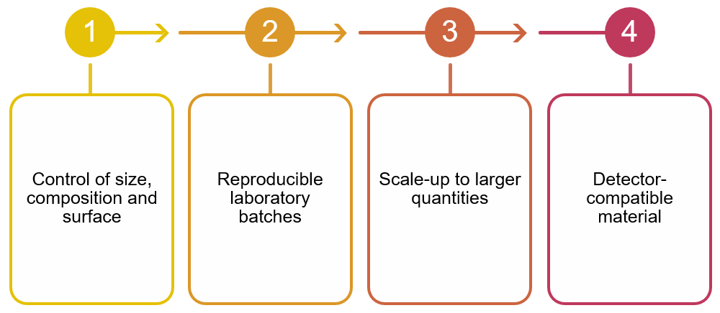
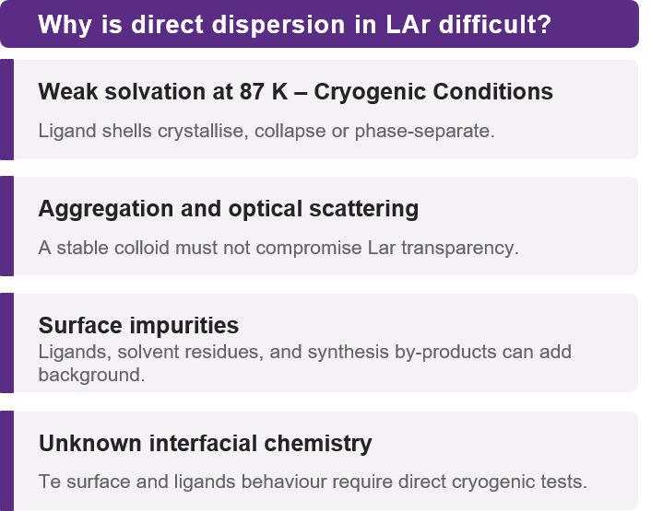
From Lab Synthesis to Detector-Scale Loading
How can we develop Te nanoparticles through a simple, controllable and scalable synthesis route for future detectors?
Can the synthesis use accessible precursors and mild conditions?
Can size and surface chemistry remain controlled when the batch size increases?
Can purification and handling meet radiopurity requirements?
5

Slide 6
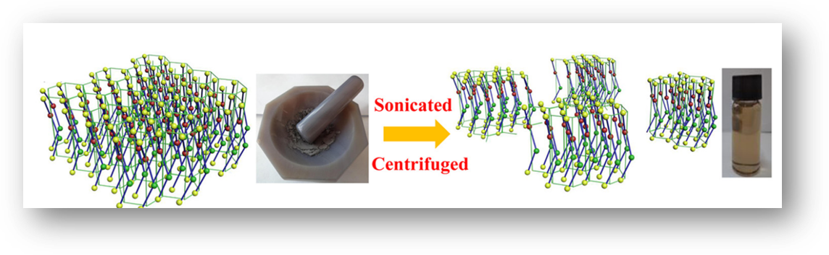
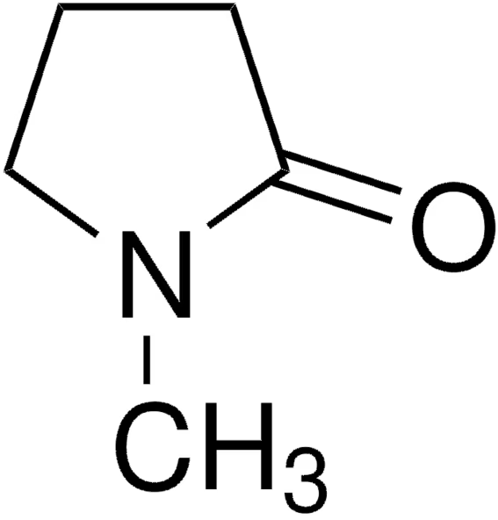
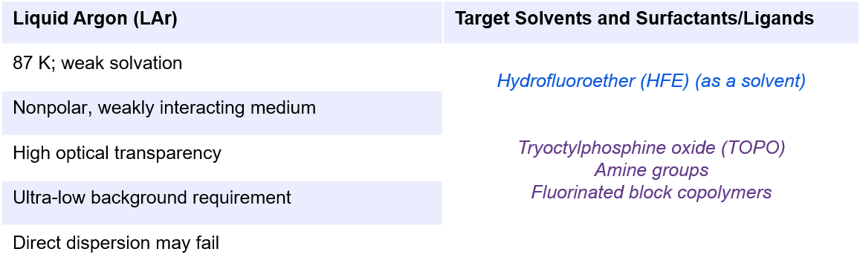
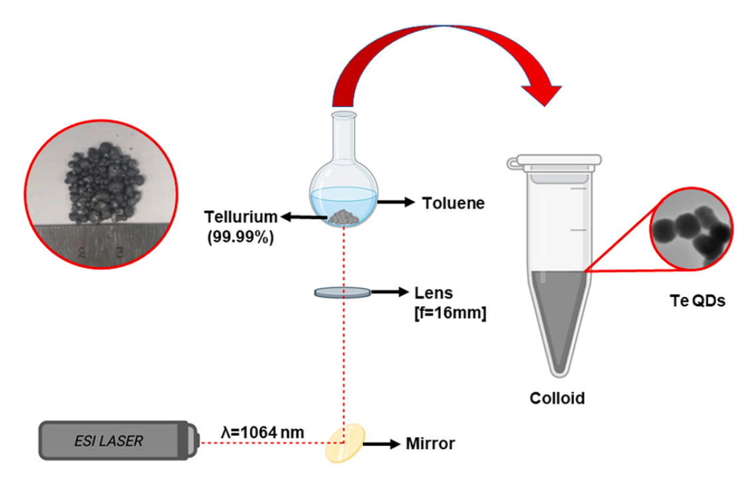
Synthetic Design Workflow
1 - Exfoliation and Ultrasonic Bath Method
0.5 g of Te powder was ground into ﬁne powder
50 mL of 1-Methyl-2-pyrrolidone (NMP) as solvent and surfactant.
2 - Bottom-ablation method
Unknown effect on the scintillation yield and pulse shape
Type of Laser | λ (nm) | Repetition rate (Hz) | Time (min) | solvent | Fluence (Jcm⁻²)
Nd:YAG | 1064 | 1000 | 5 | Toluene | ~ 131
Lu et al. Appl. Phys. Lett. 2027, 111, 063112.
6
Sudeti et al. ACS Omega 2024. 2024, 9, 25832−25840.
Notes:
So, our immediate goal is not detector loading itself, but to establish a reproducible Te-based nanoparticle platform. Two established, easily synthesised that can be modified to give us excellent nanoparticles.

Slide 7
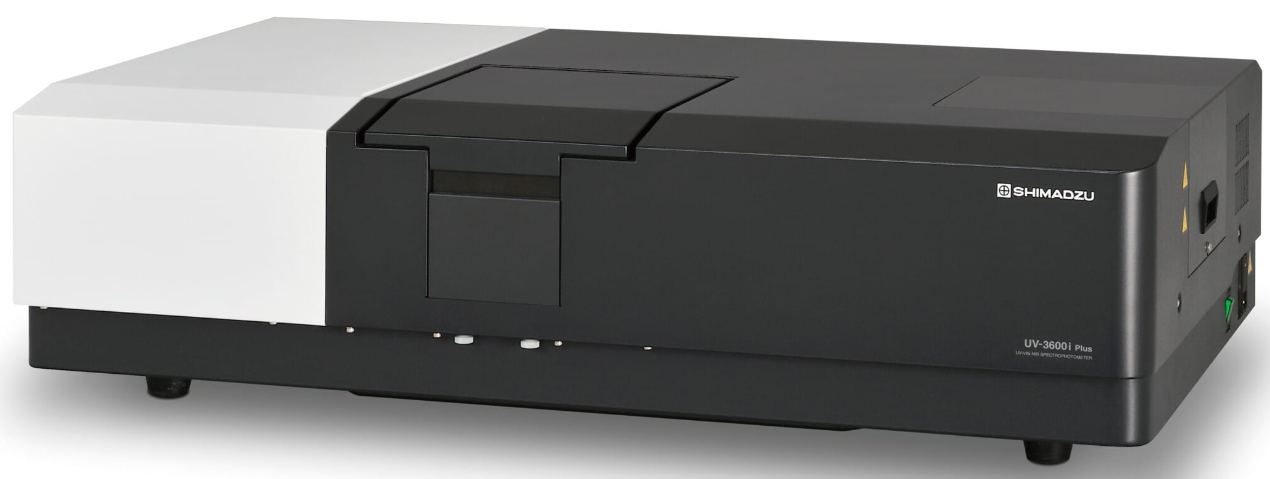
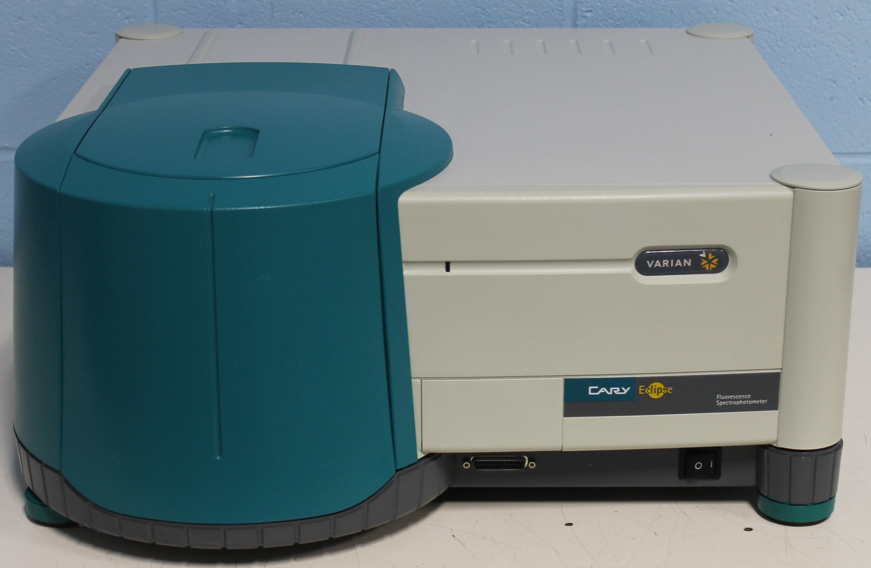
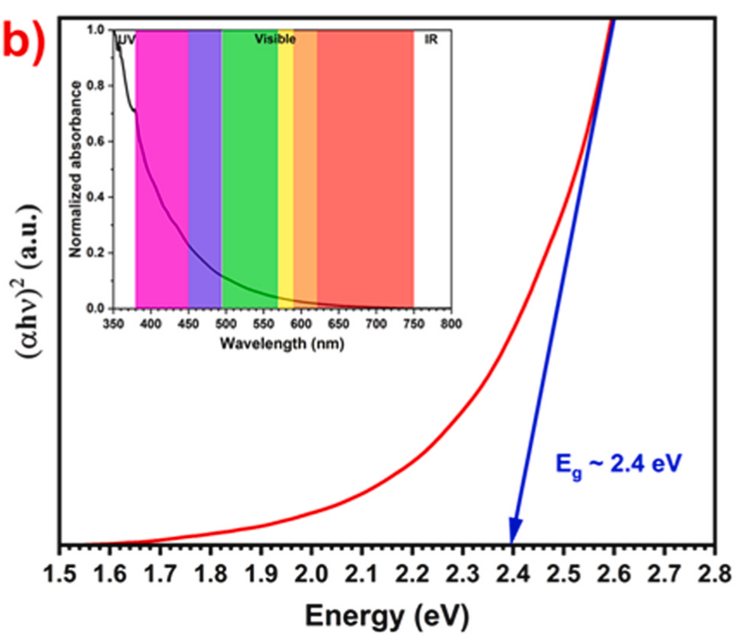
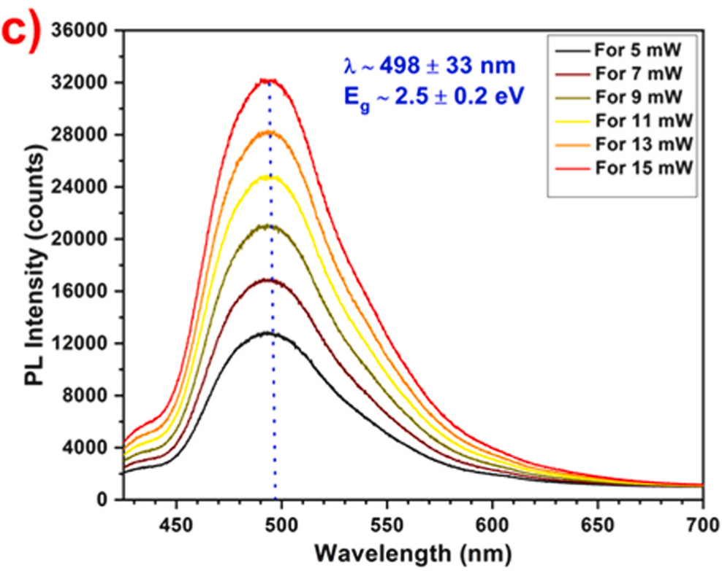
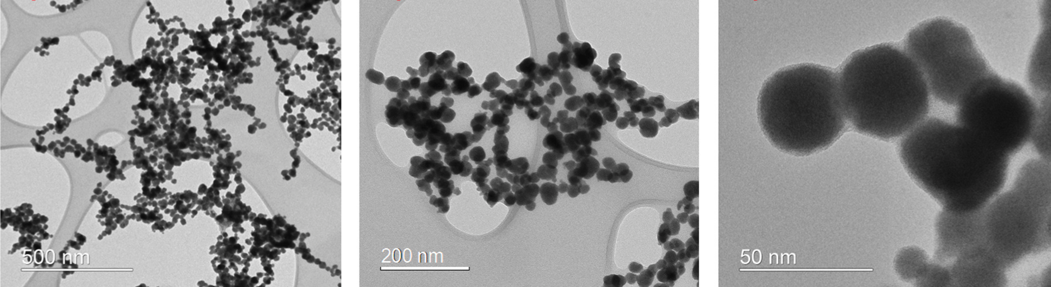
Optical and Structural Characterisation
1 – Optical Properties
At Room Temperature
Transparency and Attenuation: UV spectrophotometry at 128 nm (LAr emission) and wavelength-shifted light (350 – 450 nm) with photoluminescence spectra (PL).
Light Yield (Photons/MeV): Quantifying quenching effects introduced by tellurium nanoparticle concentration.
Varian Cary Eclipse Fluorescence Spectrophotometer
2 – Structural Properties
Shimazu UV3600i plus
Determine crystalline phases, crystal size, and lattice strain.
Visualise particle shape, size distribution, and surface morphology.
7

Slide 8

Summary
Promising Concept: Te nanoparticles offer a versatile way to combine isotope loading (¹³⁰Te) with optical photon management in future LAr detectors like ARGO.
Key Challenges Identified: Overcoming weak solvation at 87 K, preventing particle aggregation, and ensuring ultra-low background/radiopurity are critical next steps.
Ongoing R&D Workflow: Systematic efforts are underway: from scalable synthesis and surface ligand engineering to comprehensive optical (UV-Vis/PL) and structural (TEM/XRD) testing
8

Slide 9




Collaborations
https://nanoxo.eu/company/
9

Slide 10
13–15 Oct 2026 | Helmholtz Institute Mainz (HIM)
Thais
Silva
THANK YOU

Slide 11
Backup slides
11

Slide 12
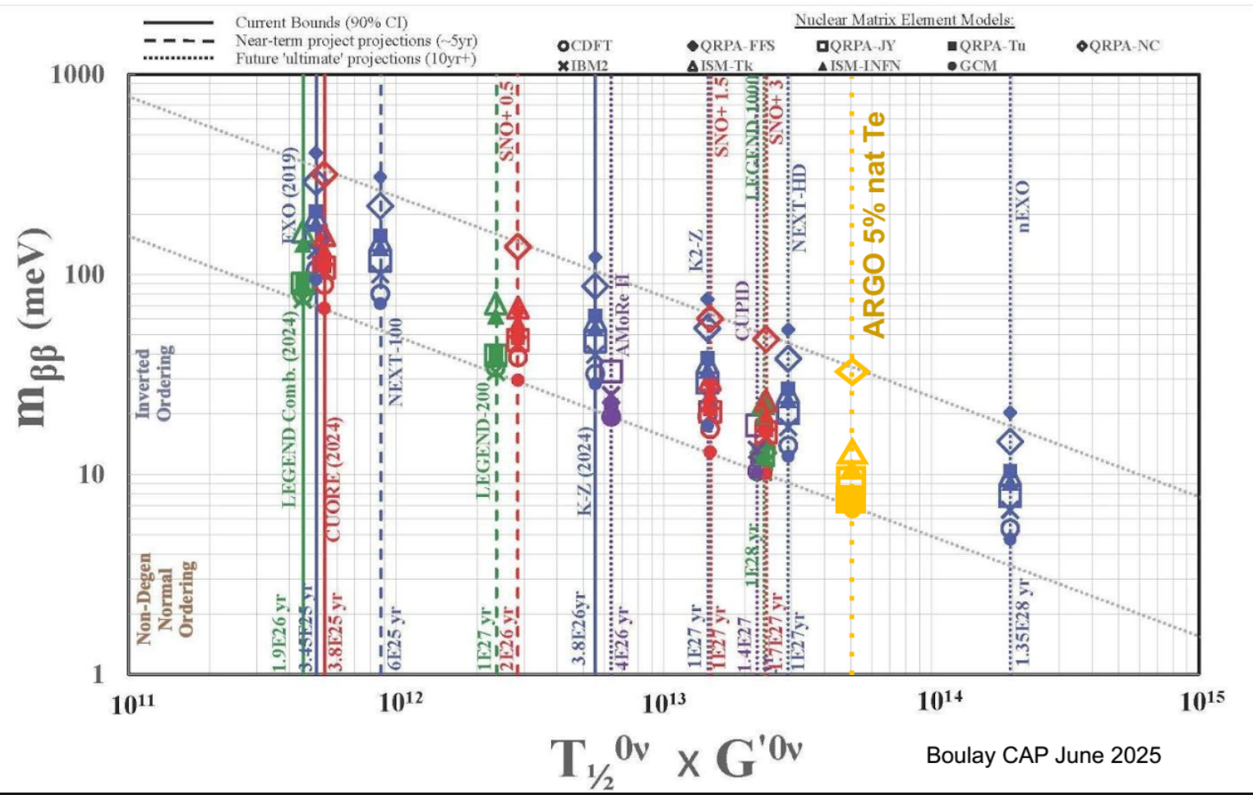
ARGO Sensitivity for 0νββ
The yellow marker labelled 'ARGO 5% nat Te' shows the long-term projection for the proposed ARGO experiment, using natural Tellurium loaded in a liquid scintillator.
12
Notes:
Because it reaches half-life sensitivities beyond ${10}^{28}\text{ years}$, its target effective mass ($m_{ββ}$) drops below $10\text{ meV}$, pushing deep into the Normal Mass Ordering regime. The stack of yellow symbols reflects the theoretical uncertainties from the different Nuclear Matrix Element models.

