Slide 1

Status MESA
SFB Students workshop
Schwäbisch Gmünd, Tue 09/23/25
Kurt Aulenbacher for the MESA team
Institut für Kernphysik, Johannes Gutenberg-Universität Mainz

Slide 2
Outline
ERL‘s and the future of accelerator based particle physics
Mainz Energy-recovering Superconducting Accelerator (MESA) and
its potential impact
MESA‘s experimental line-up
Status of the project

Slide 3
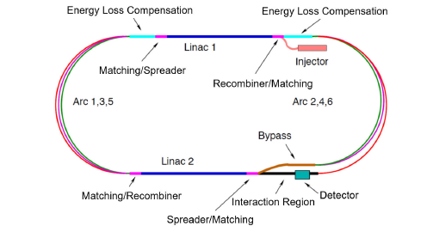
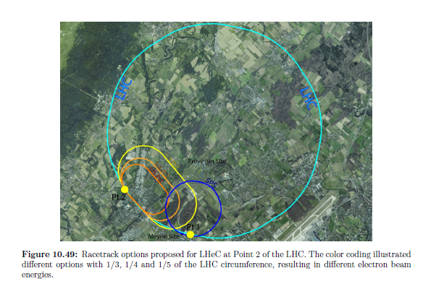
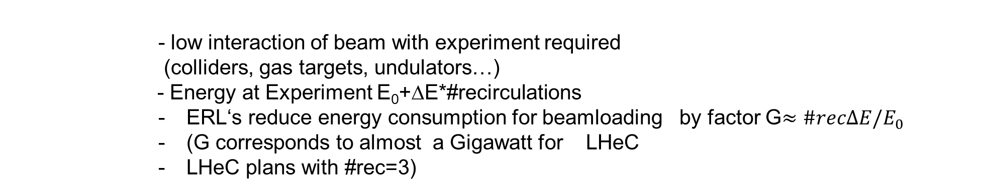
Large Scale ERL‘s: The LHeC
1km
3 recirculations, 50 GeV, 20mA Linac-current…
could be realized „soon“
CERN-ACC-Note-2020-0002
- low interaction of beam with experiment required
(colliders, gas targets, undulators…)
- Energy at Experiment E₀+ΔE*#recirculations
        ERL‘s reduce energy consumption for beamloading by factor G$≈\#recΔE/E_{0}$
        (G corresponds to almost a Gigawatt for LHeC
        LHeC plans with #rec=3)

Slide 4
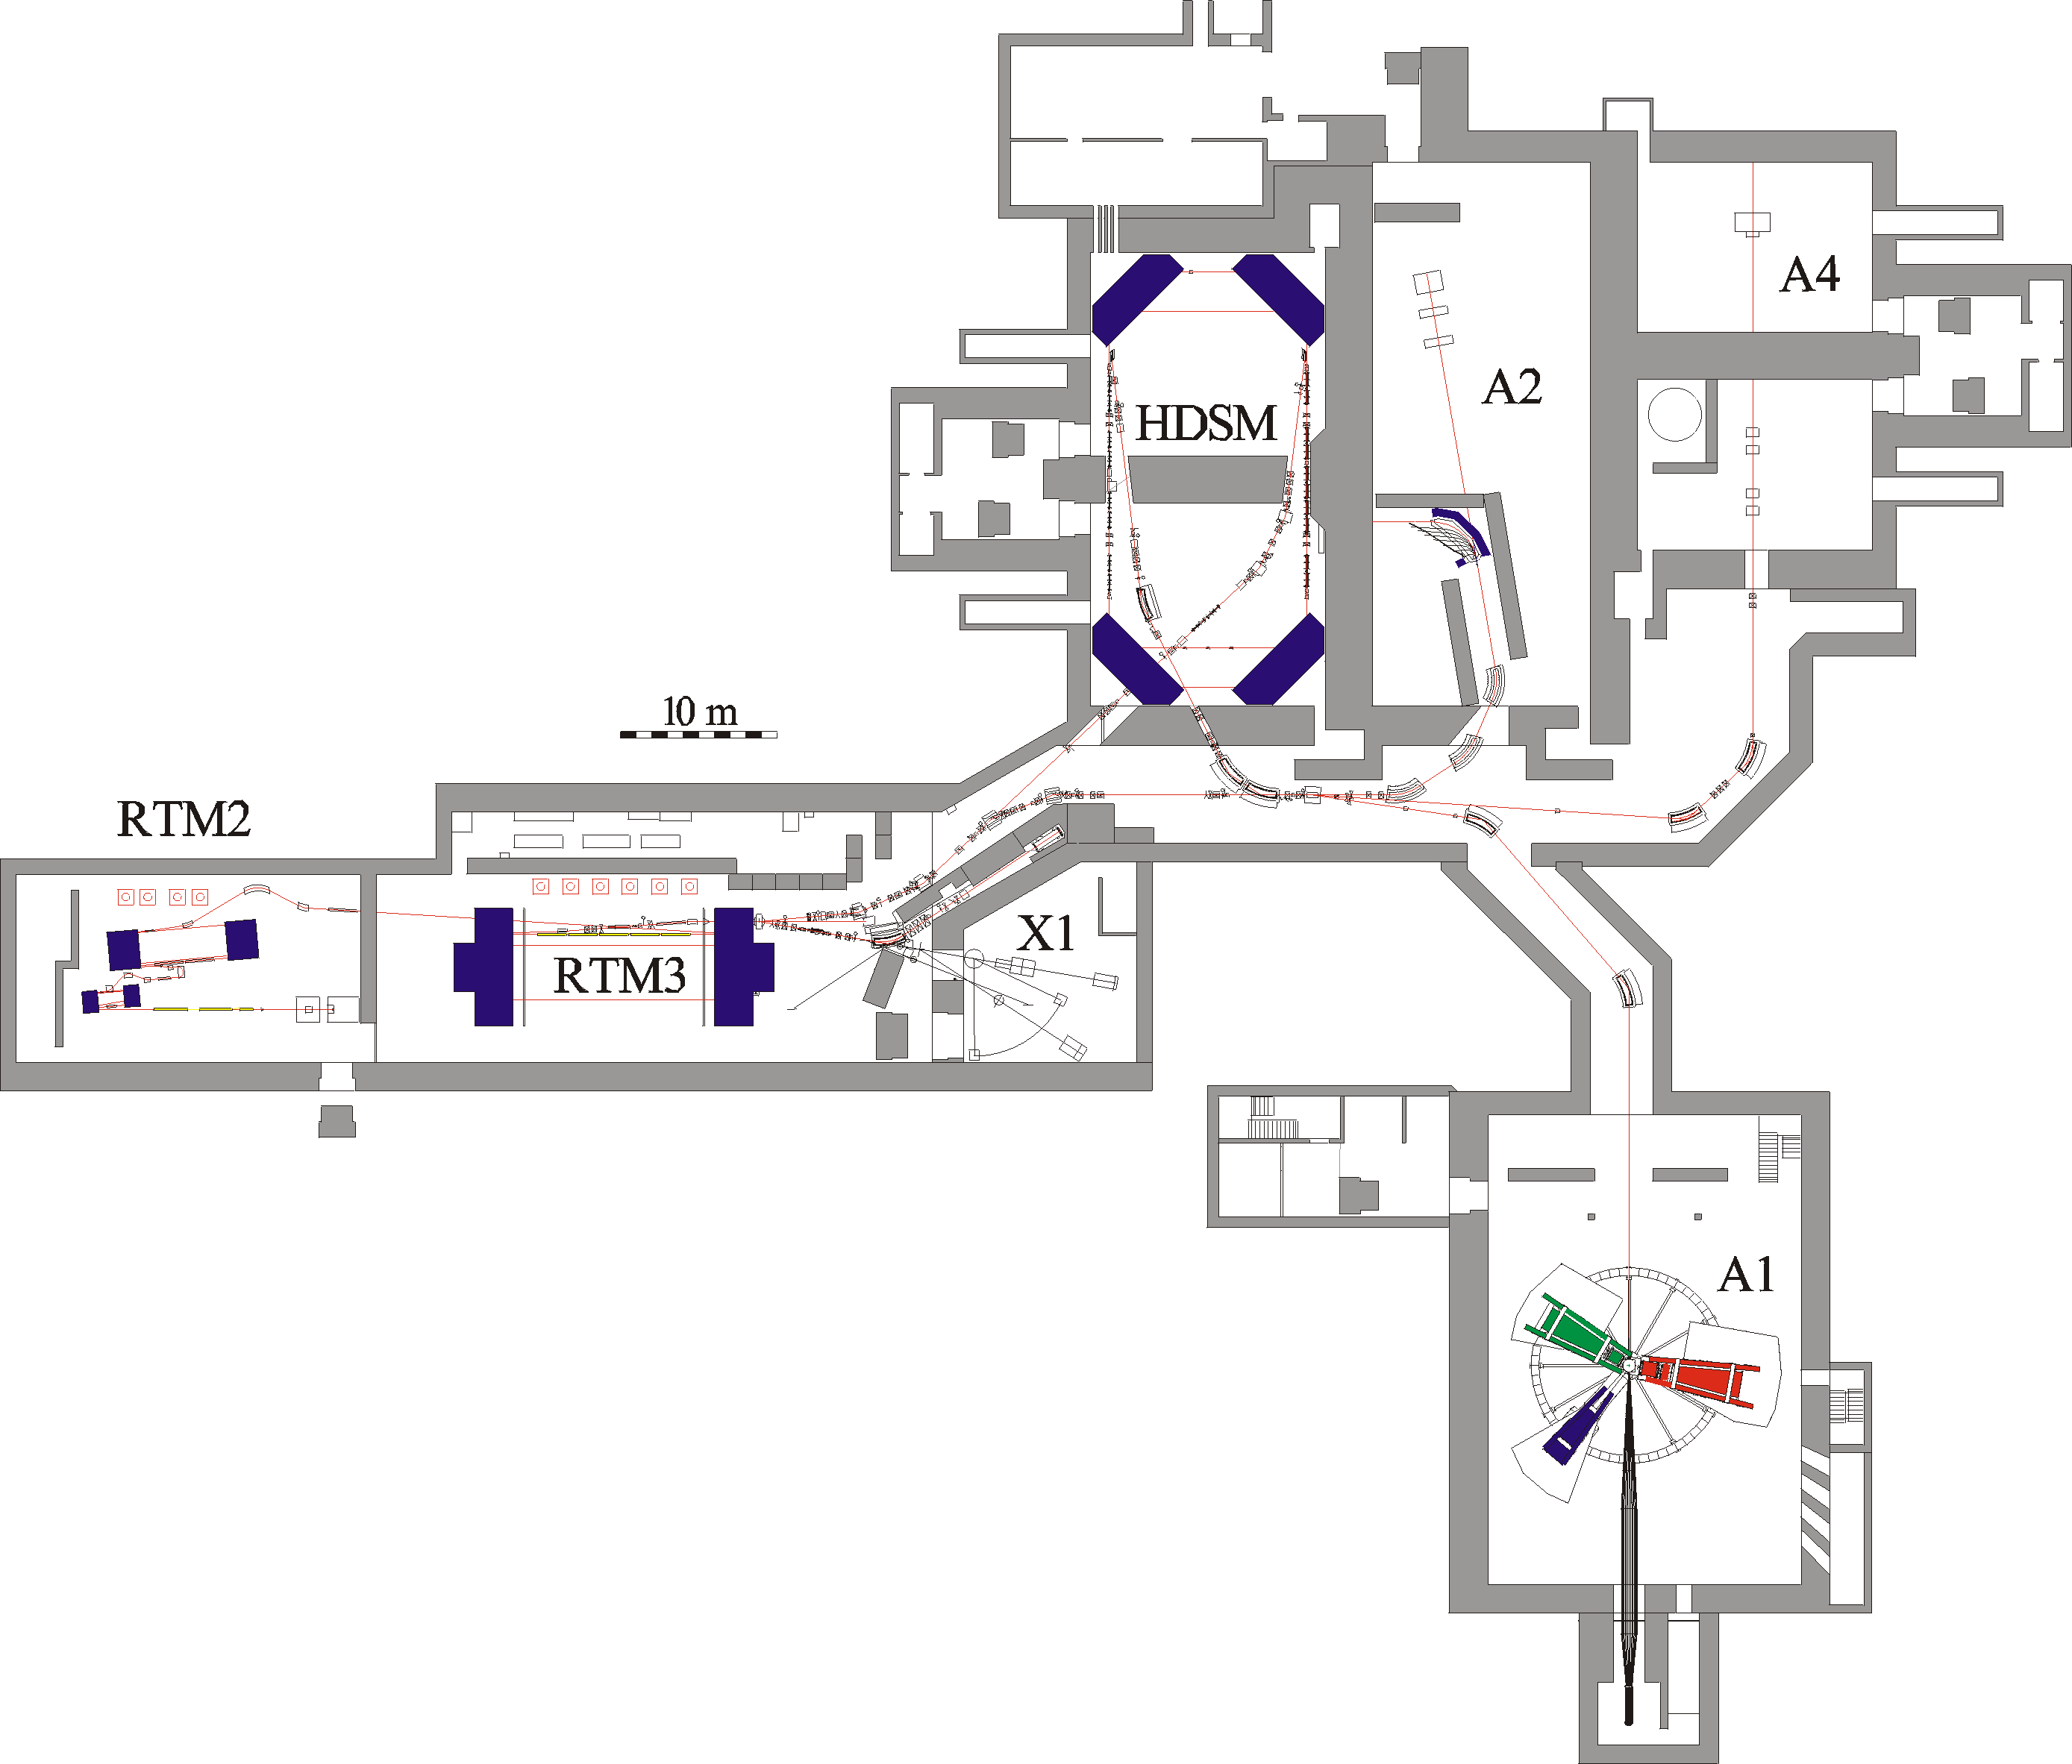
Example for multi-turn
Normal conducting
recirculating accelerator:
Mainz Microtron cascade
(MAMI-C)
Multi turn recirculation, e.g. 90 times in RTM-3
1.6 GeV beam energy, c.w. beam
up to 150kW beam power
RF-installation : 18 Klystrons (each: 50kW RF, >100kW wall plug)
In operation since 2007.
Power consumption ~3MW

Slide 5
New project: MESA
(Mainz Energy-recovering
Superconducting Accelerator)
„World class“ electron scattering experiments below Pion production threshold
Requires at least 10 times beam intensity of MAMI (1-10mA vs. 0.1mA)
MESA energy consumption 30% of MAMI
Blue area available for MESA + extension building

Slide 6
MESA has a goal related to the development of particle acclerators:
MESA as multi-turn SRF ERL will help extrapolating towards large scale ERL-projects,
i.e. reduce project risks

Slide 7
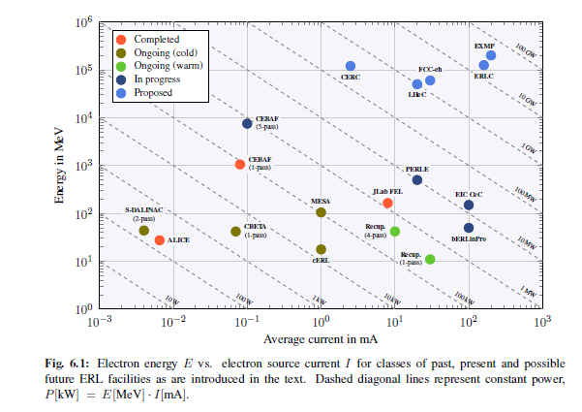
MESA in the (future) Landscape
The largest beam power in multi-turn superconducting ERL has been achieved at TU-Darmstadt !
European strategy for particle physics
Accelerator R&D roadmap
CERN 2022-01
(modified)
MESA stage 2
(10mA)

Slide 8
MESA has another scientific goal:
MESA is a machine that is optimized to serve
specific nuclear and
particle physics experiments

Slide 9
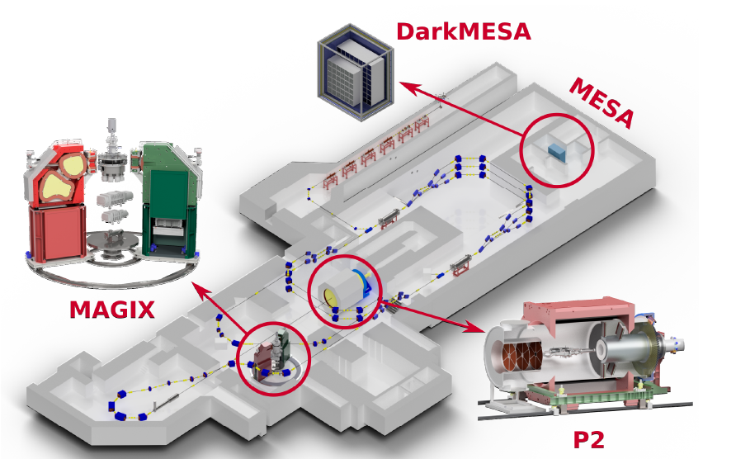
MESA Operational modes & Experiments
Op-mode | Target | Beam power@target
Ext. Beam (EB) | Solid/ Liquid | 0-25kW
Energy recovery(ERL) | Gas-jet | 0.1-1MW
Dark-MESA

Slide 10
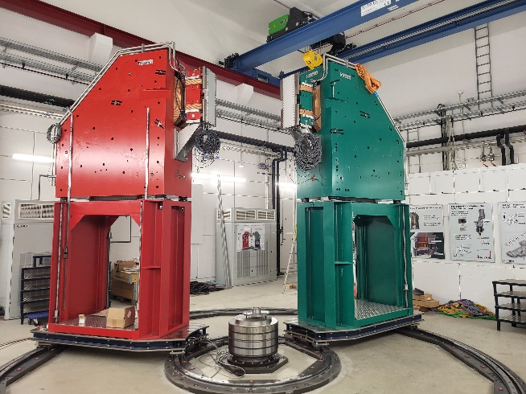
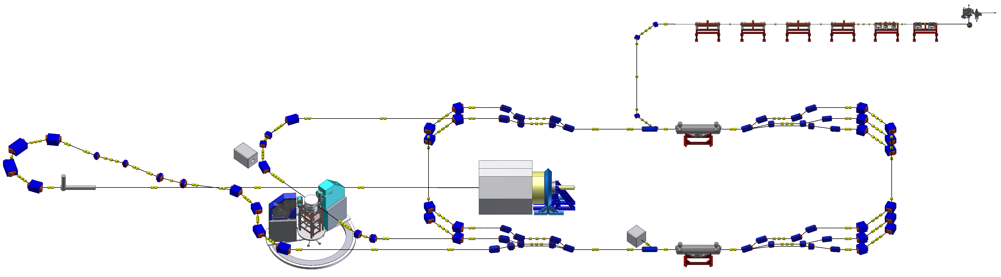
Energy Recovery Mode – MAGIX
Deceleration
Acceleration
MESA will be a two-turn superconducting ERL
Aims to demonstrate significantly higher beam currents than at existing multiturn-superconducting ERL‘s
- Staged approach, adapted to needs of experiments (55 MeV EB, single turn ERL,…)

Slide 11
Gas Jet target at MAMI A1 /MAGIX
Gas Jet target designed
by AG Khoukaz from
U- Münster
→ And tested with beam at MAMI/A1
H.Merkel Talk at DPG Springmeeting 2022

Slide 12
Experimental program at MAGIX
H.Merkel Talk at DPG Springmeeting 2022

Slide 13
Accelerator devices for Experiments-MAGIX
NEW due to ERL/gas target vs. already established at MAMI:
NEW: Kollimation system → example
Established Non-invasive beam diagnostics & feedback →see P2
Established Beam dump (concept, installation ongoing)
Established: Absolute energy calibration

Slide 14
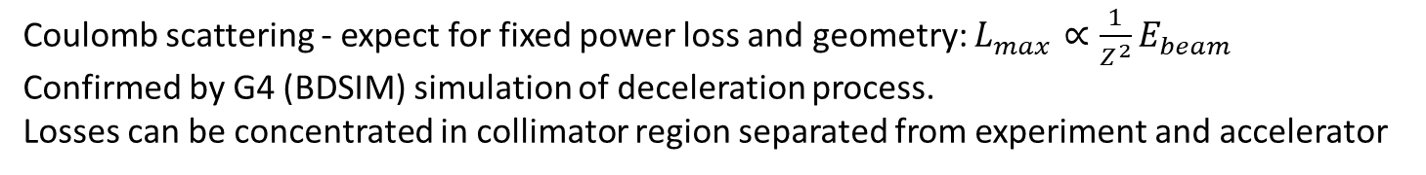
Luminosity limitation ERL gas jet target
Coulomb scattering - expect for fixed power loss and geometry: $L_{max}∝\frac{1}{Z^{2}}E_{beam}$
Confirmed by G4 (BDSIM) simulation of deceleration process.
Losses can be concentrated in collimator region separated from experiment and accelerator
Results for „two collimator“ system at 100kW, 105MeV
Total loss <100 Watt, loss in accelerator <0.05 W.
Ben LeDroit, PhD thesis Mainz 2021
Calculation for realistic MAGIX geometry
http://doi.org/10.25358/openscience-5808

Slide 15
Acclerator devices for Experiments-P2
- nothing fundamentally new, but huge improvements wrt MAMI needed
Non-invasive beam diagnostics & feedback
Polarimetry
Helicity switching speed *20

Slide 16
EB-Experiment P2
D. Becker et al. Eur. Phys. J. A 54 (2018) 11, 208
DOI: 10.1140/epja/i2018-12611-6 &166,

Slide 17
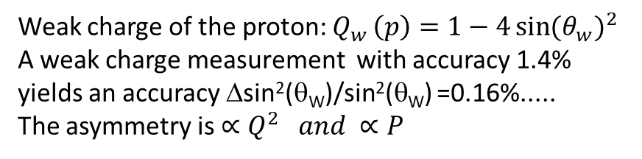
EB-Experiment P2
Weak charge of the proton: $Q_{w }\left(p\right)=1−4{\sin{(θ_{w})}}^{2}$
A weak charge measurement with accuracy 1.4%
yields an accuracy Δsin²(θ_{W})/sin²(θ_{W}) =0.16%.....
The asymmetry is $∝Q^{2 }and ∝P$
D. Becker et al. Eur. Phys. J. A 54 (2018) 11, 208
DOI: 10.1140/epja/i2018-12611-6 &166,
See talk by S. Baunack, today

Slide 18
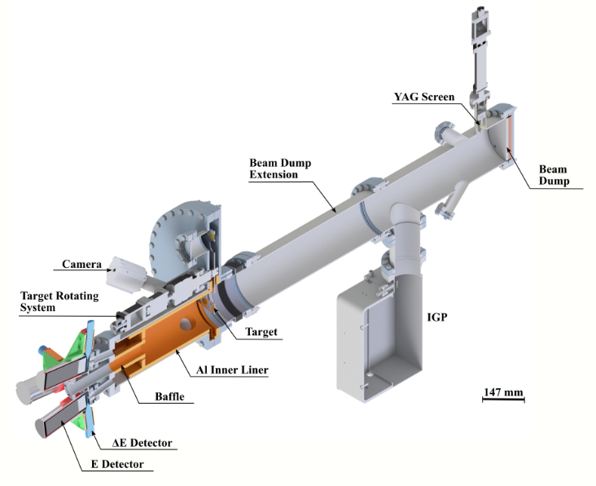
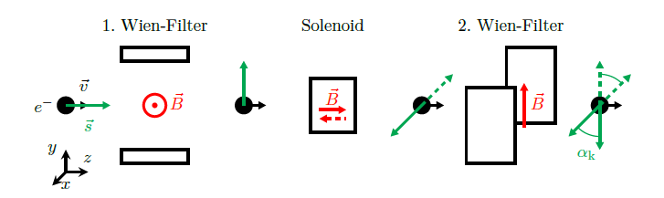
Spin polarized beams at MESA - support of P2 experiment
Accurate spin polarization measurement → Mott polarimeter (5MeV, backscattering)
Spin manipulation → „double“ Wien filter (100keV) for arbitrary orientation in space
Non invasive measurement of beam parameters under polarisation switch (various energies ) → Resonant cavity monitors
Mott-polarimeter for 174 degree
backscattering on gold at 5 MeV
Operation principle of MESA-Spin-Manipulator
(here shown option for 180 degree spin flip in acclerator plane)
BEAM
BEAM
SPIN
R. Thapa
Ch. Matejcek
Notes:
Hier das Funktionsprinzip von zwei für P2 wihcitgen Geräten. Der Mott-Polarimter soll den spin-polarisationsgrad P des MESA-elektronestrahls möglichst genau (<1% Delta P/P) messen. Dazu wird elastische Streuung (mit Spin heoißt das Mott-Streuung) unter Rückwärtswinkeln benutzt. Man misst die Asymmetrie der Streuraten , wenn der Spin senkrecht zur Streuebene liegt. Der Doppel-Wien filter soll eine Beliebige Spinrichtung im Raum erzeugen können. Insbesondere will P2 das der Spin am Target um 180 grad werden soll. Da Wienfilter bösartige Elemente sind, sollen sie dabei nicht verändert werden. Daher der Solenoid in der mitte, der den Spin entweder rechts oder linksrum in die Beschleunigerebene drehen kann. Daraus ergibt sich dann der 180 grad Veränderung, die mit entsprechendem „Vorhaltewinke“ durch den zweiten Wienfilter auch noch den Zusatzwinkel kompensiert der dadurch entsteht dass der g-faktor des Elektrons nicht genau =2 ist (sog (g-2)-präzession). So kann das Experiment einen Spin-Flip um 180 grad erhalten, ohne dass man die Polarisation an der Quelle ändern muss. Das ist wichtig für die Kompensation der systematischen Effekte (sog. „falsche“ Asymmetrien)

Slide 19
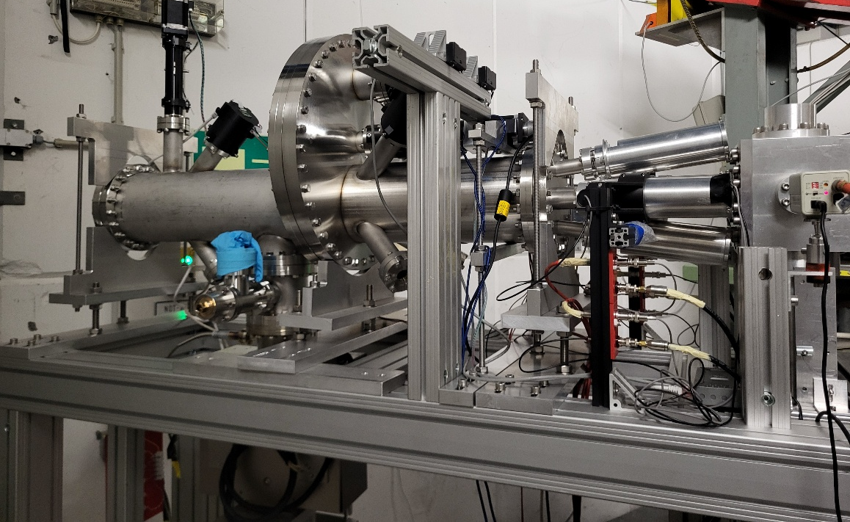
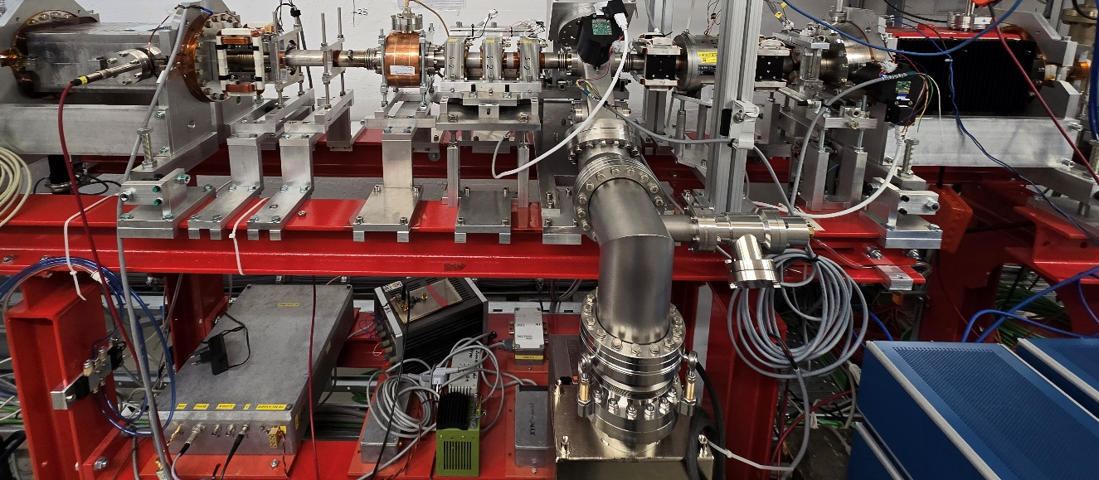
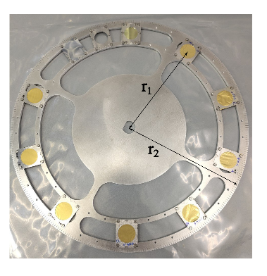
Spin polarized beams at MESA - support of P2 experiment
Mott polarimeter under test at MAMI: Detection system works, first asymmetries on gold targets measured
„Double“ Wien filter (100keV) both Filters and Solenoid operated with beam at parameters for 90 degree rotation
kHZ-rate polarization switching obtained and beam current variation detected with 2.6 GHz RF-Monitor
Bunched polarized beam achieved by photo.source using RF-synchronized high power fiber laser (150ps FWHM)
MESA-Mott under test at MAMI
Elastic backscattering under 174 degree
Wien filter assembly/HF-monitor at MESA
Target
chamber
Detectors
Wien-2
HF-monitor
Solenoid
Wien-1
Th. Beiser et al.
Gold targets
R. Thapa
~2 m
~1.8m
Notes:
Hier sieht man wie weit die Geräte entwickelt sind. Der Mott-Polarimeter wird derzeit mit dem 3.5 MeV Strahl von MAMI getestet. Man braucht Asymetriemessungen an Targets verschiedener Dicke (die übrigens in Frau Lommels Labor an der GSI hergestellt wurden) , Dicken zwischen 0.1 und 2 Mikrometer. Man muss die Asymetrie nach Foliendicke Nul lextrapolieren, weil die Vielfachstreuung die Asymetrie hinsichtlich der theoretisch berechenbaren (Sherman Funktion , S, genannt) vermindert. Der Zusammenhang zwischenAsymetrie und Strahlpolarisation ist A=S*P man bestimmt also P=A/S. Bei 174 Grad Streuwinkel und 5 MeV ist S ca. 0.5. Die Messung geht also sehr schnell, weil die Asymtrie sehr groß ist, die Strahöpolarisation ist so etwa 80%. Im rechten Bild sieht man, dass der Aufbau des Spinrotationssystems abgeschlossen ist. Es wurde auch schon mit den Feldern Betireben, die die maximalen Spindrehwinkel (90 Grad herstellen) , und zwar ging auch der Strahl schon mit >99% transmission durch. Die berührungslose Strahlstrommessung geht auf der zweiten harmonischen der MESA frequenz (2.6 GHz, Grundfrequenz 1.3 GHZ), da ist der Resonator recht kompakt., siehe rechts Bild.

Slide 20
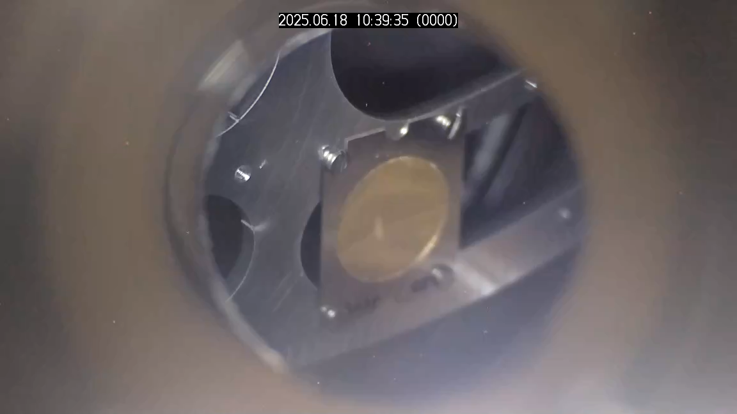
Deformation of 2μm Gold Target due to thermal stress(?)
Observation of optical transition radiation at 3.5 MeV
M. Dehn/R. Thapa

Slide 21
Status of installation

Slide 22
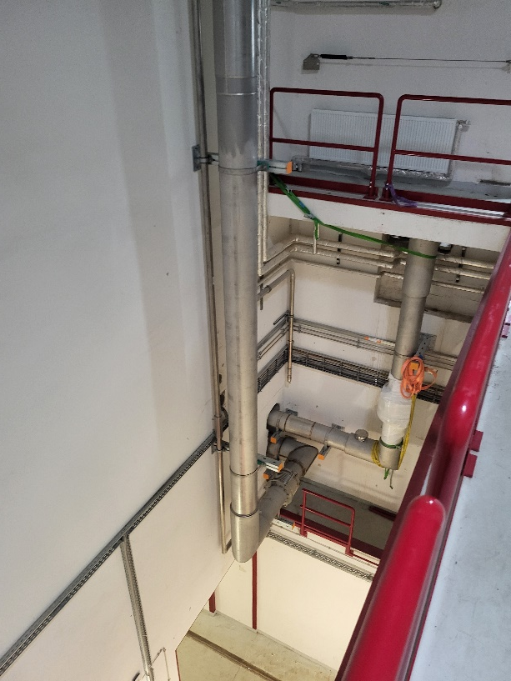
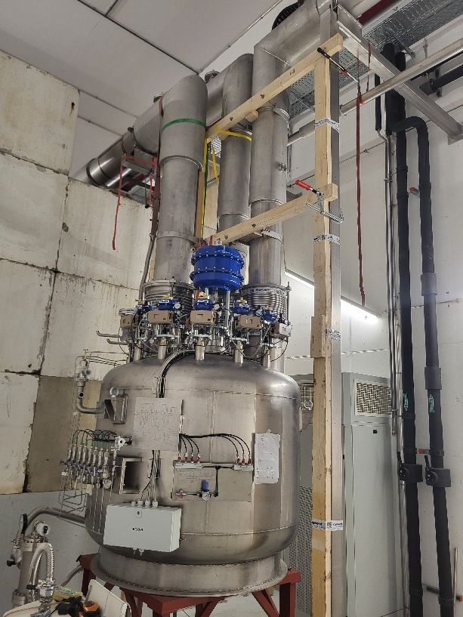
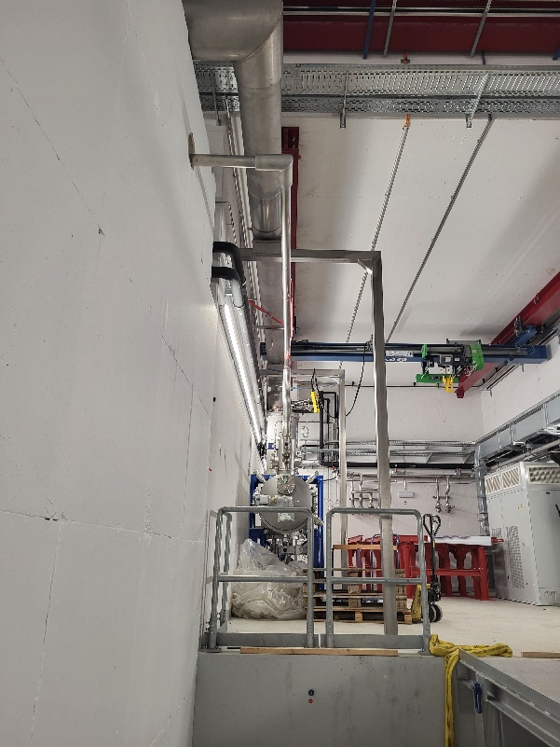
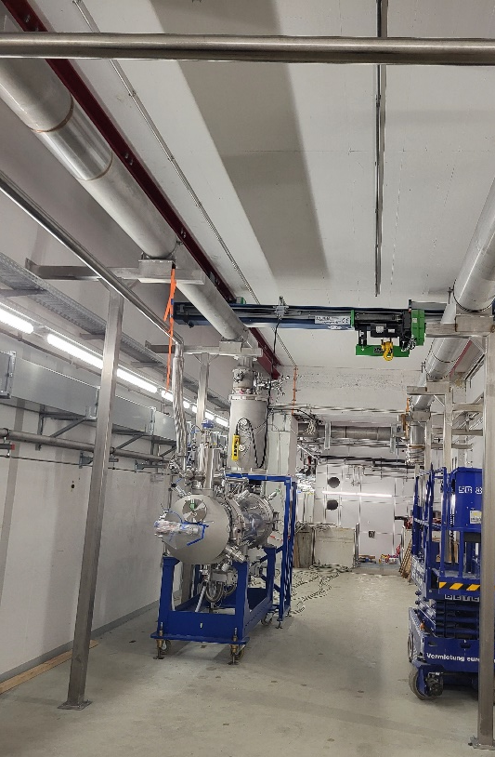
December 24 – installations begin…
Cryomodule 2 connected to cryo-line
in „beam position“ at corridor East
Cryomodule 1 connected to cryo-line
in „beam position“ at corridor West
Cryo-lines installed in
„Shaft east“
LeHe distribution
In central cryobunker
(Hall-1)

Slide 23
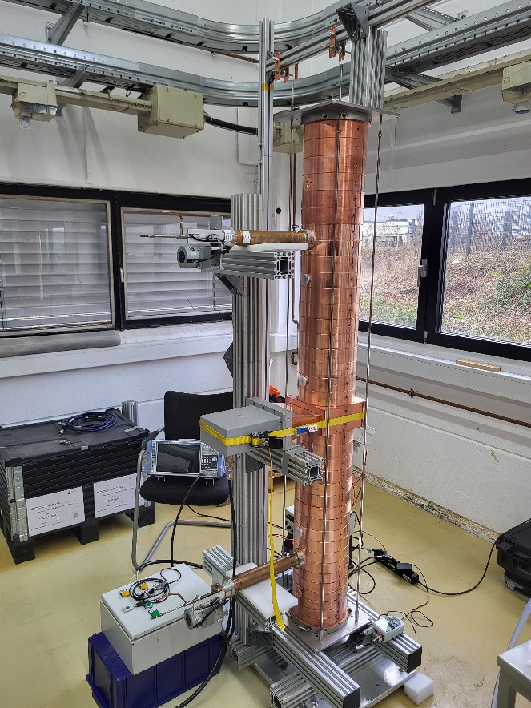
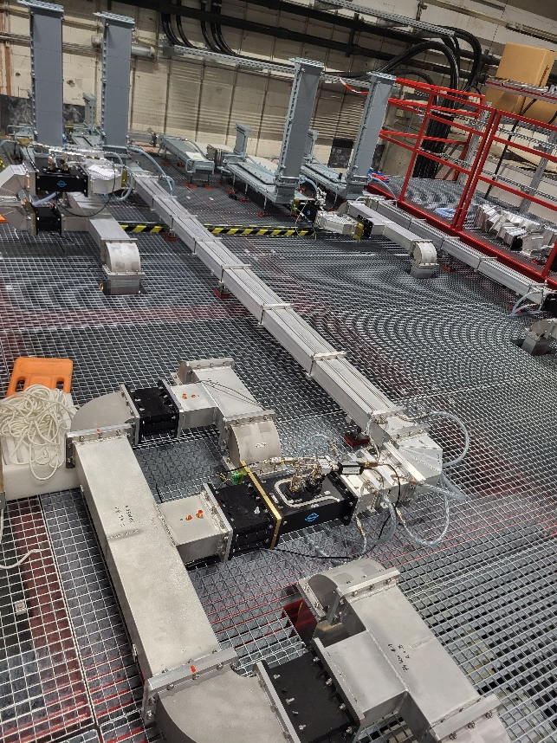
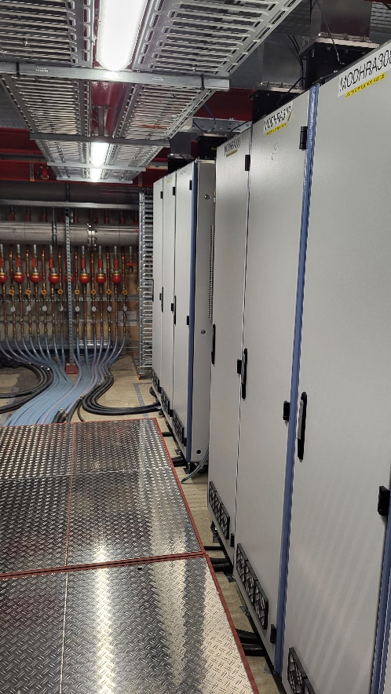
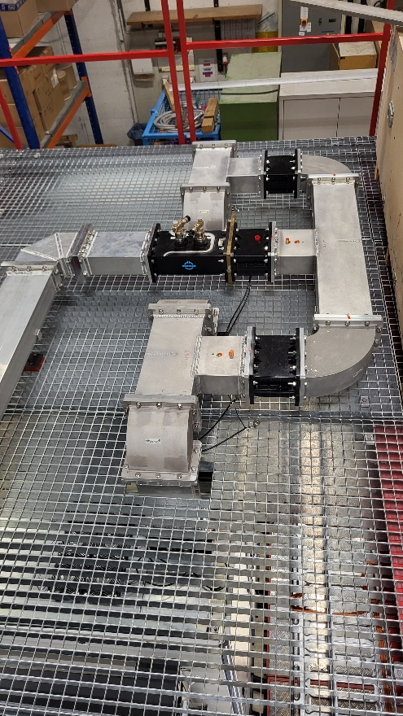
RF system
RF-section-1 („graded beta“)
of normal conducting
CW 5 MeV injector
„MilliAMpere BOoster“
aka „MAMBO“ (10mA)
20kW 1300 MHz
solid state amplifier modules
total 17 modules
4*20kW get combined
-providing power
for RF-Section MAMBO-1
Waveguides direct
power to circulators and
finally to RF-sections
behind shielding walls

Slide 24
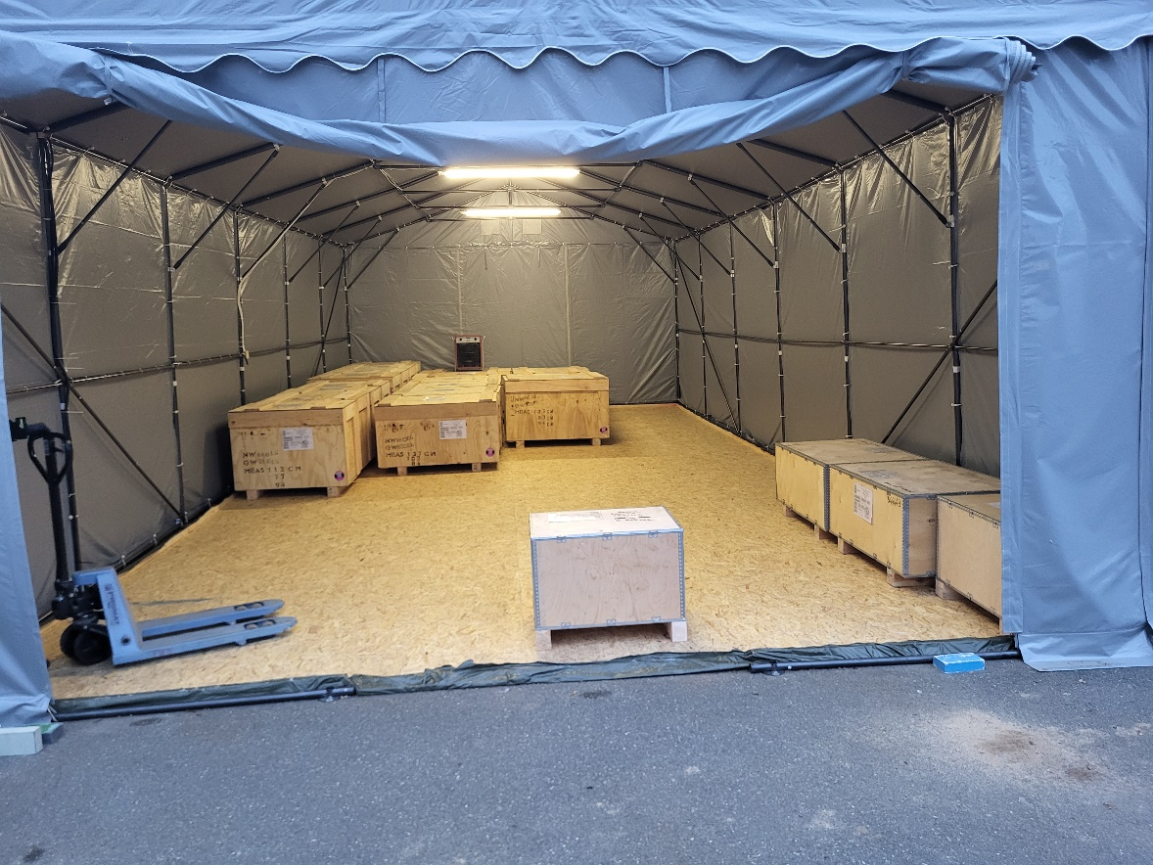
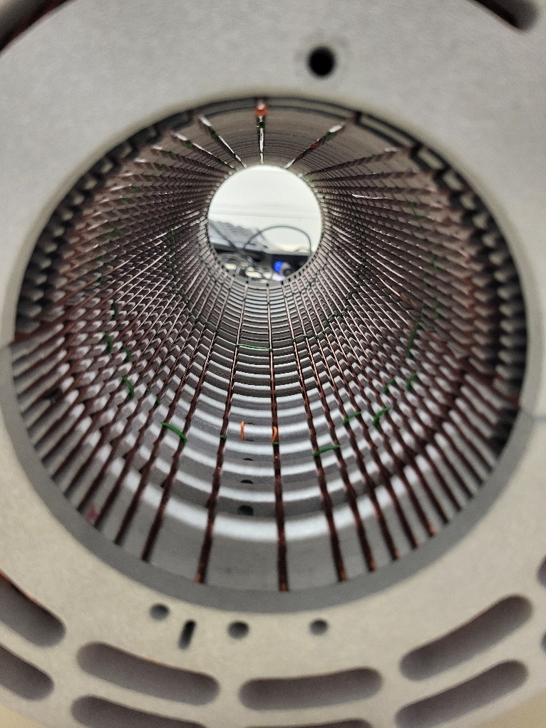
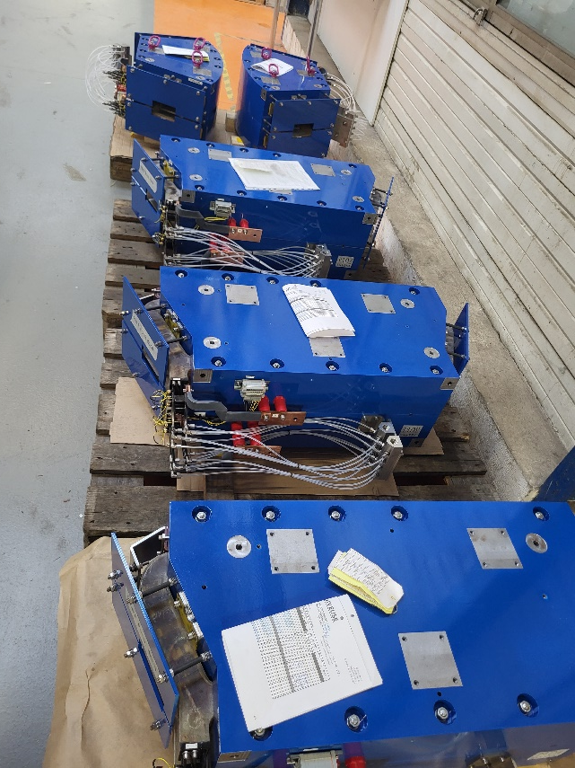
Magnets for accelerator
Intermediate storage space… All 105 Dipole magnets delivered . Magnetic measurements ongoing
MESA 45 degree arc magnets
Special magnet: Air coil 7.5 degree
deflector for 5MeV Mott polarimeter
(V. Tioukine )

Slide 25
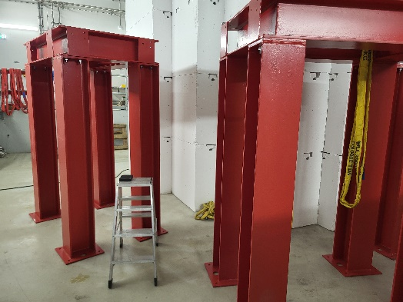
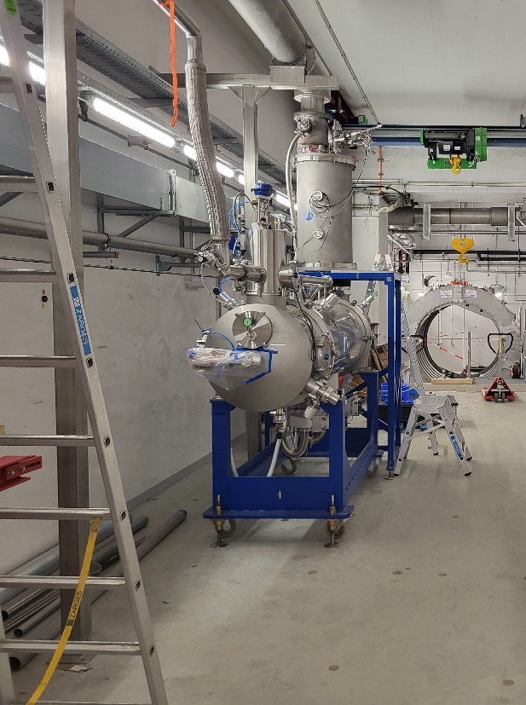
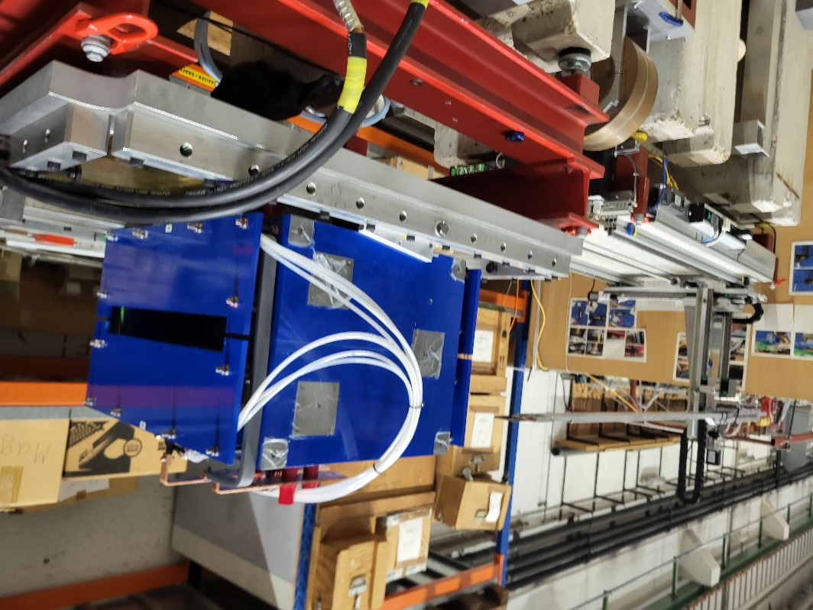
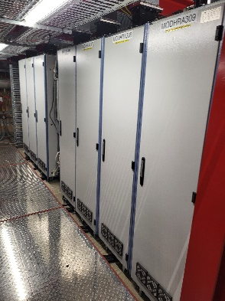
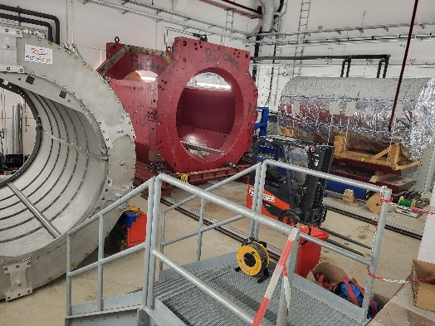

Status: Some of the milestones achieved
HIM building functional since 11/24 → Building controlled by KPH→„Schlüsselgewalt!“
All RF-transmitters (17 modules) installed and operational (total 300kW RF-power)
Cryomodules installed at operating position, Helium liquefier upgrade completed.
All Dipole magnets (+ dipole vacuum chambers) delivered, sample specimen tested
Cryo-piping completed
1
2
1
2
3/5

Slide 26
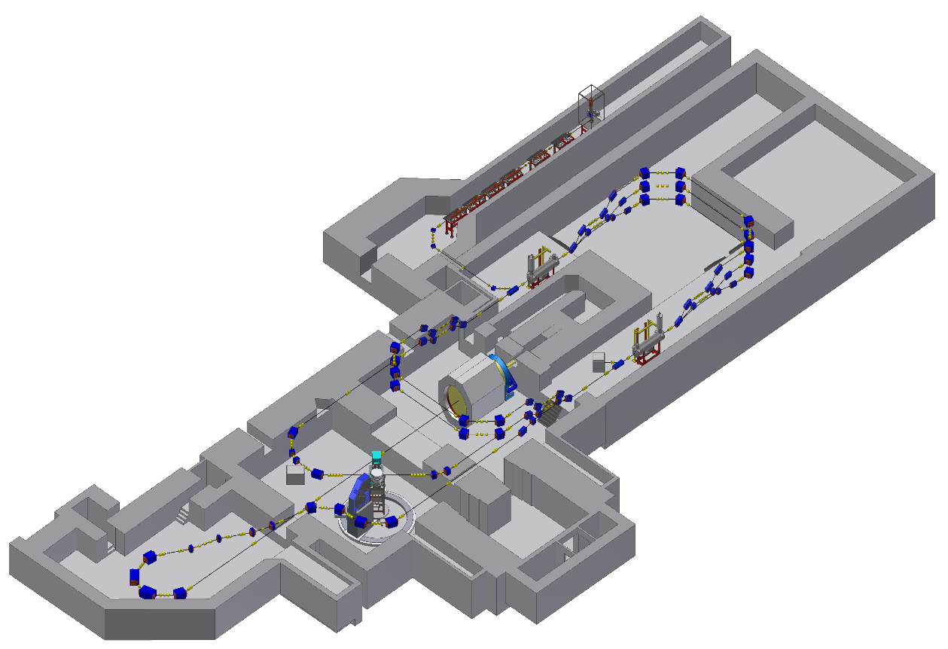
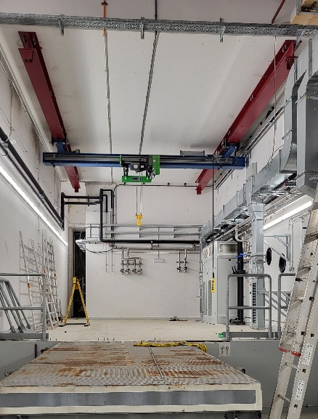
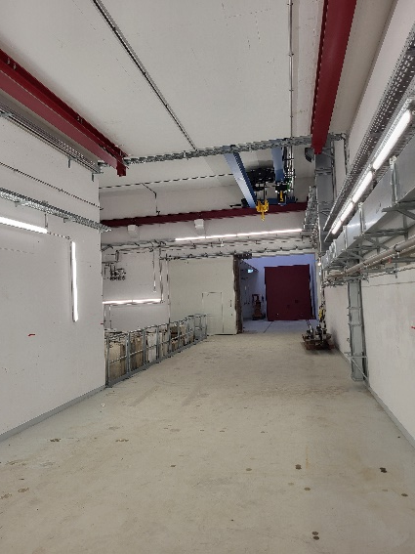
Injector tunnel &
RF-installation area
Next bigger steps and (many smaller ones):
Cool down and test SRF modules as soon as installation of P2 solenoid completed (FEB 26)
Continue installation of
100 meter long beamlines (Accel, MAGIX, P2)
Install MAMBO injector
Go for first beam 55MeV EB to experiment
in October 2026
instrum
Hall-2: P2-experiment
Hall-3: MAGIX
New building
(Hall-1)
Hall-4:
Beam stabilization
and polarimetry
WEST Corridor
(October24)
EAST Corridor
(October 2024)

Slide 27
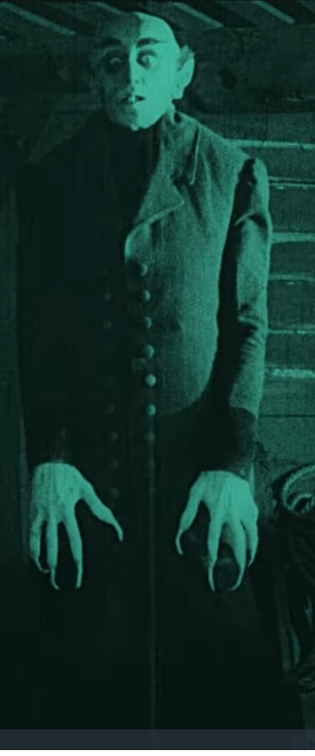

Risks (selection)

Slide 28
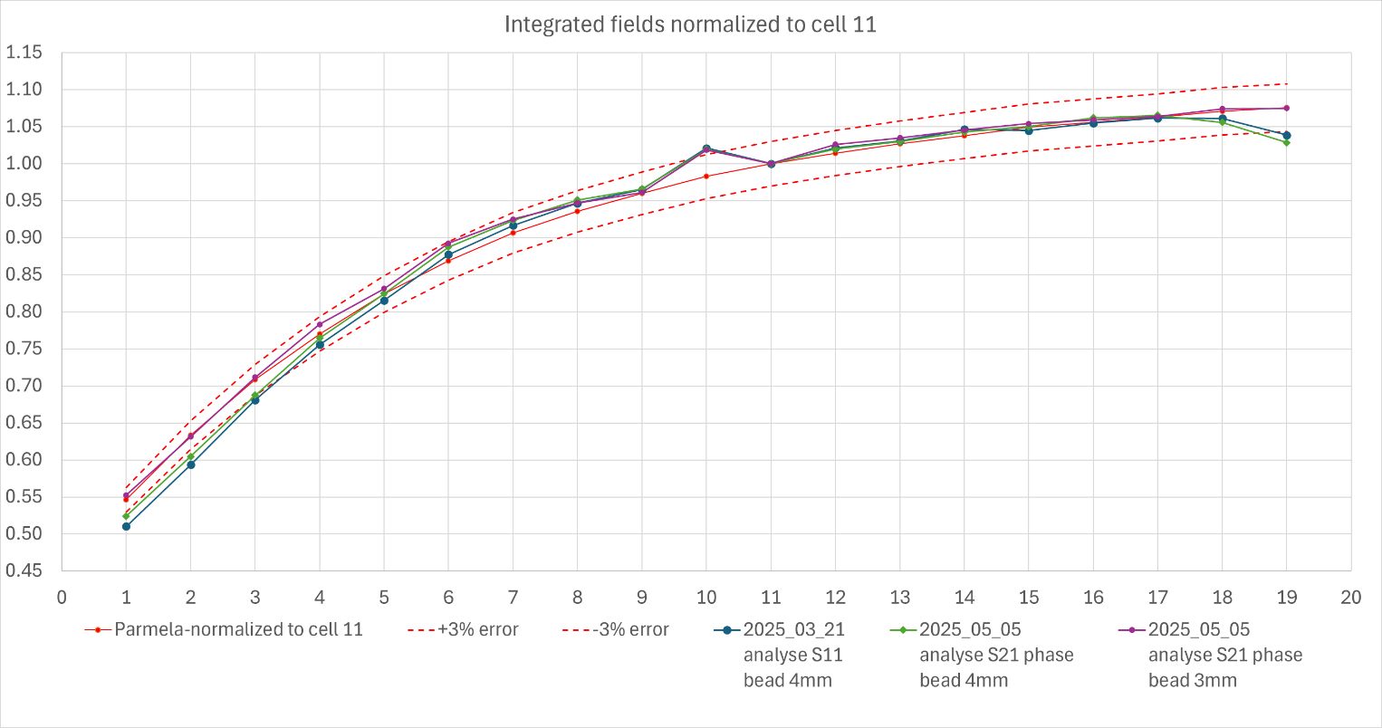
Risks (Selection)
Last “high-tech” component missing (ordered 12/2019!)
RF-structure MAMBO 1 (“graded beta”):
Manufacturer claims to have solved problems with field distribution.
Final soldering process and FAT next week!
RF-section-1 („graded beta“)
of normal conducting
CW 5 MeV injector
„MilliAMpere BOoster“
aka „MAMBO“ (10mA)

Slide 29
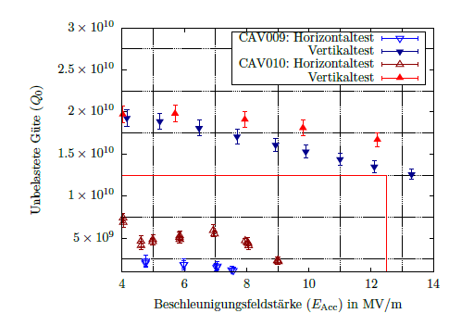
Risks (Selection)
Cryo-plant : 4 complex components from different vendors interact→ sustained operation?
Probability: Medium; Impact : costs + several month delay
Cryomodules: Deterioration of cavity quality factor since tests at HIM? (particulate contamination?)
Probability: low-medium, Impact: high (costs + 1 year delay)
Effect of deterioration
(PhD Thesis T. Stengler )
But, meanwhile, we can repair cavities!

Slide 30
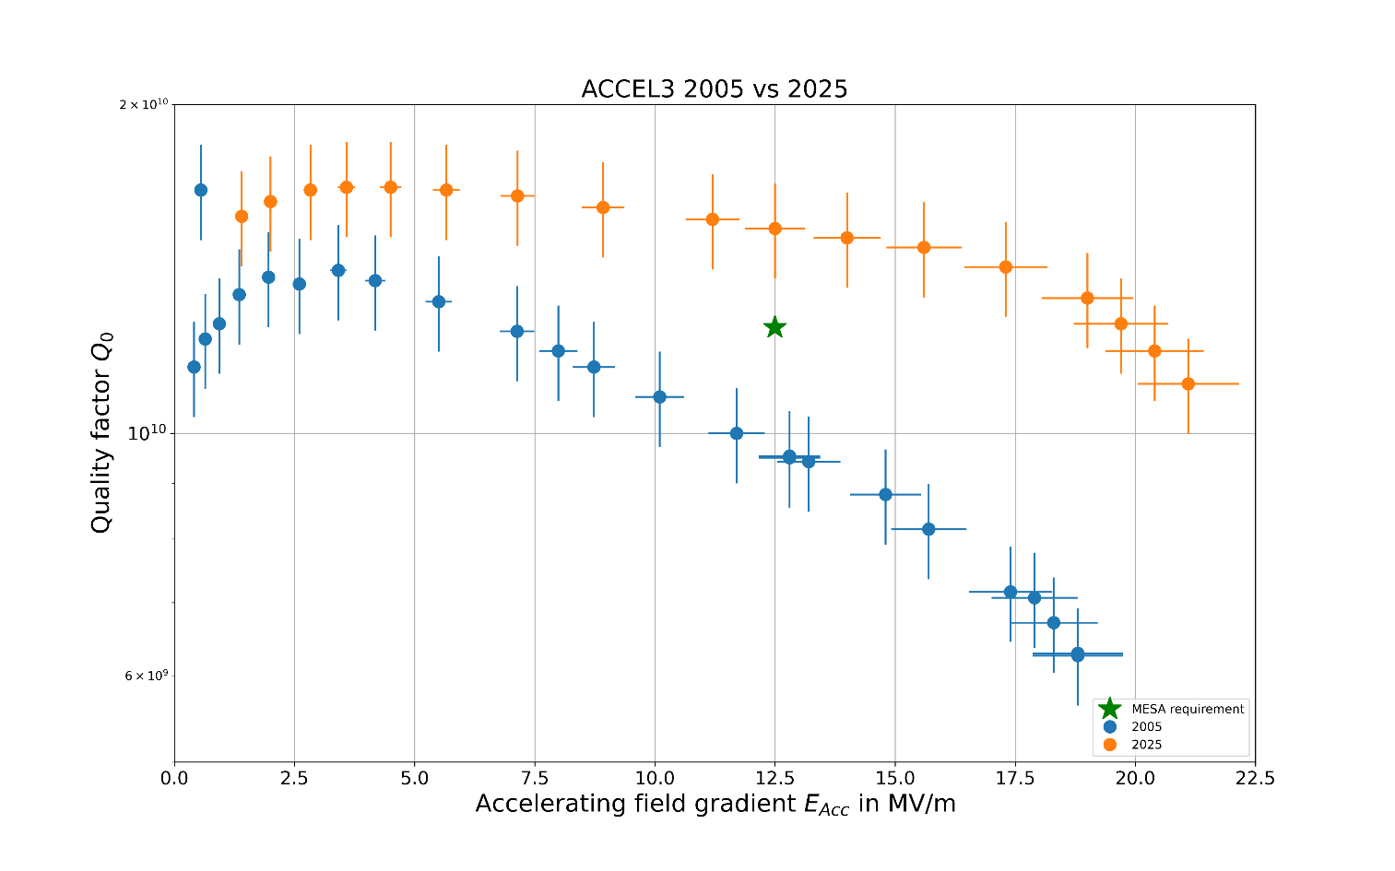
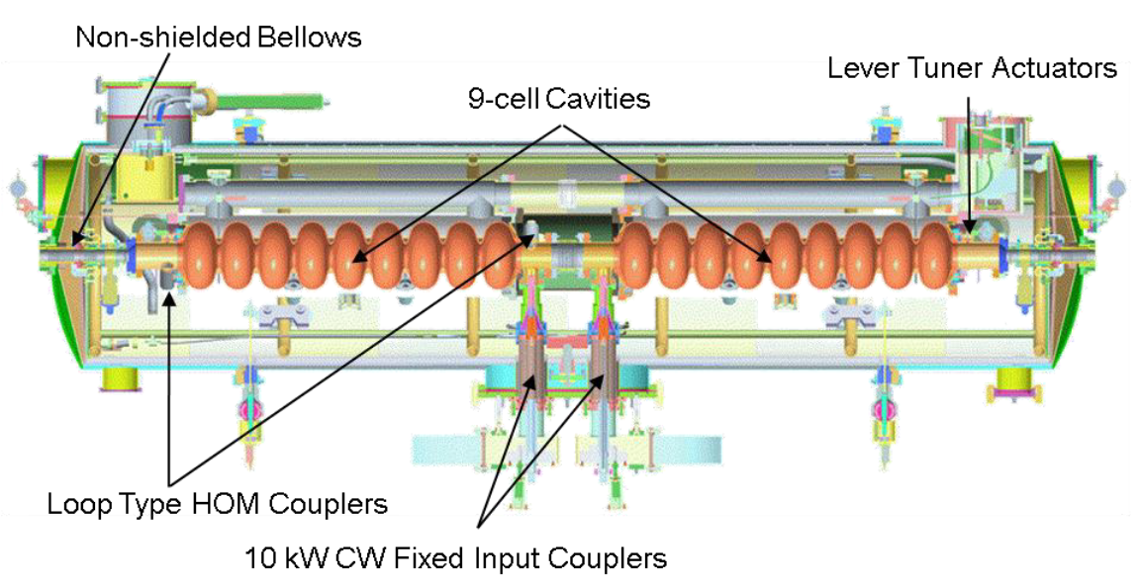
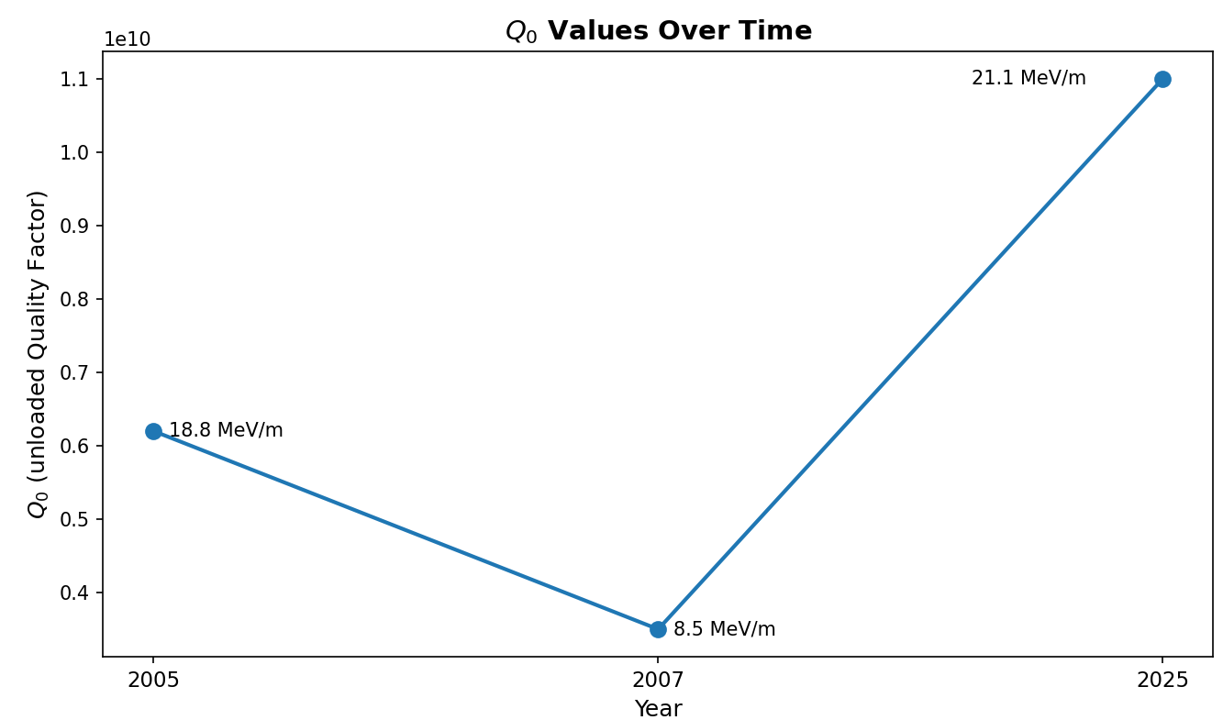
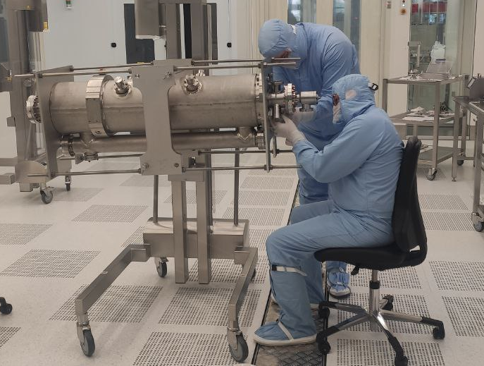
Refurbishment of MESA Cavities @ HIM
HIM Cleanroom usage for MESA cavities
Particle freedom required – ISO‑4 limits to avoid field‑emission
Cleanroom infrastructure @ HIM with high pressure rinsing (100bar) allowed a professional cleaning
Recovery of dirty SRF cavities successful with bad quench limit and quality factor (8.5 MeV/m @ Q₀=3.5e10) to state of the art (21.1 MeV)
State‑of‑the‑art cleaning (equal to DESY, J‑Lab) allows cavity usage in MESA and SRF research
MESA@HIM
Vendor cleaning
Other lab

Slide 31
Thank you!

Slide 32
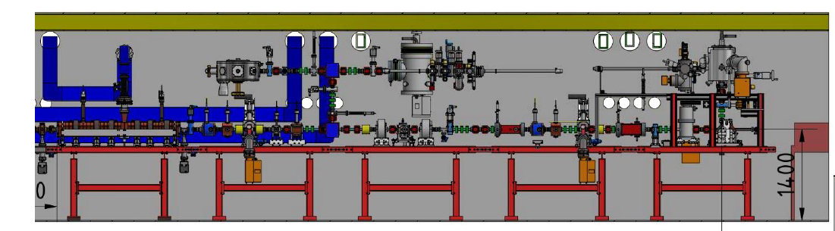
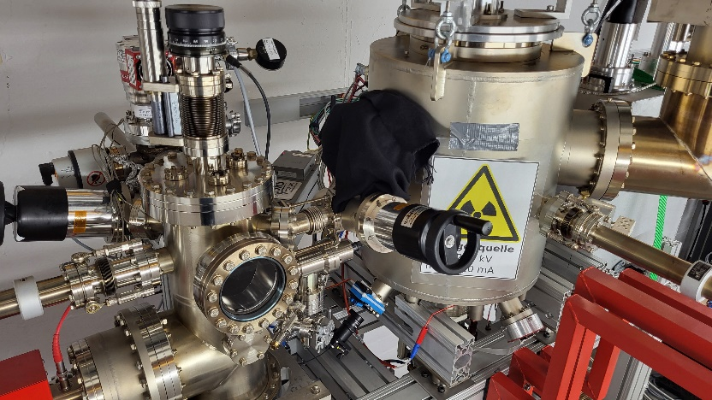
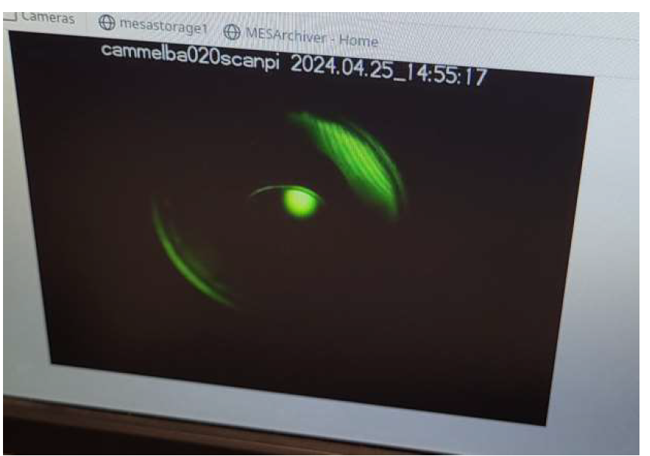
MESA spin polarized photosource „STEAM“
Laser
type | Er-doped fiber
wavelength | 780nm
Av. power | Up to 4 Watt
Rep-rate | 5-1300 Mhz
Pulse length | 50-250ps
STEAM
photocathode
type | GaAs/GaAsP SL
wavelength | 780nm
Spin-polarization | 80-90%
Quantum efficiency | ~0.5% (3mA/Watt)
Response time | ~1ps
Beam current | 150μA
Charge lifetime | >100 Coulomb
Spin-polarized cathodes are „activated“ on-site and transferred
to source in UHV
First beam from
Spin-polarized
Photosource
„STEAM“
Laser

Slide 33
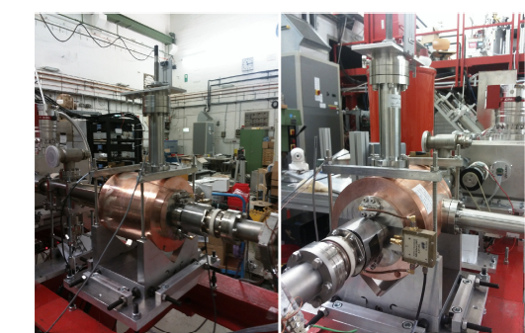
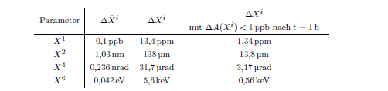
Requirement:
Good S/N, high sensitivity, high bandwidth → determine fasle asymmetry within reasonably short time with sufficient accuracy
MESA XY Monitor
Sensitivity: ~1Volt/(mm*μA)
R. Kempf et al.
Beam parameter stabilization for the P2 experiment at MESA
https://doi.org/10.1016/j.nima.2020.164554
Already
demonstrated
Beam parameter noise at 1kHz measurement rate
To achieve desired accuracy after 10000 hours
- or 10* less accuracy after 1 hour…

Slide 34
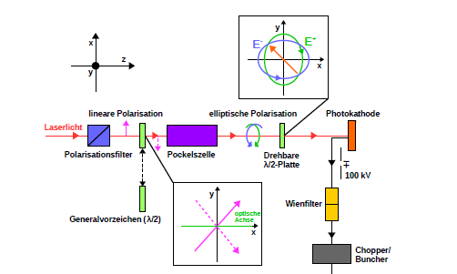
False asymmetries and their compensation
Helicty correlated intensity fluctuation
Caused by inhogeneous strain relaxation in photocathode (~1% asymmetry)
Compensation by directing (minimized) linear polarization componenents diaganal wrt strain relaxation
This allows few ppm ΔX_{current}

Slide 35
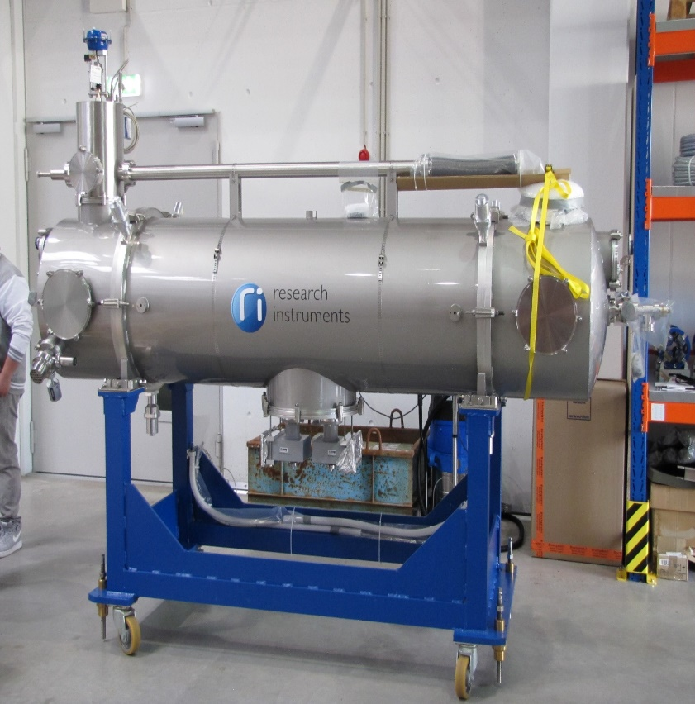
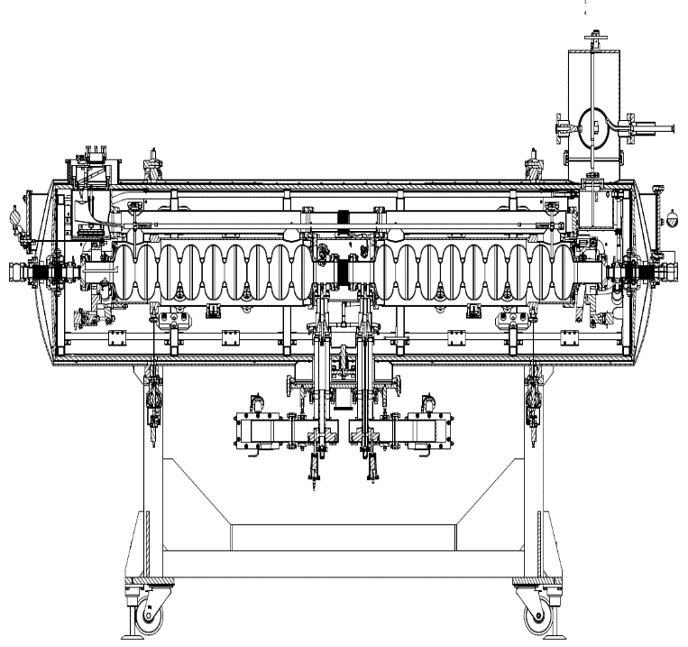
If normal conducting RF and Magnets are‘nt enough trouble
– try SRF and SC-magnets! (….but trouble is our business)
3.5 meter
2-SRF modules Specs: 25MeV Energy gain at <40 Watt thermal loss at 2Kelvin-SAT successfully completed in August 2020 (!)

Slide 36


Slide 37


Slide 38
Requirement:
Good S/N, high sensitivity, high bandwidth → determine fasle asymmetry within reasonably short time with sufficient accuracy
MESA XY Monitor
Sensitivity: ~1Volt/(mm*μA)
R. Kempf et al.
Beam parameter stabilization for the P2 experiment at MESA
https://doi.org/10.1016/j.nima.2020.164554
Already
demonstrated
Beam parameter noise at 1kHz measurement rate
To achieve desired accuracy after 10000 hours
- or 10* less accuracy after 1 hour…

Slide 39

MESA source spin rotation/spin control
MAMBO
Beamspot Nov. 24
2mm
Remaining parts of 100keV-MesA Low-energy Beam Apparatus (MELBA) will be assembled still in 2024
MAMBO (Milliampere Booster) will be installed until early summer 2025
1kHz spin flip
by Laser-EOM
Second Wien
Filter for compensation of
(g-2) precession
in MESA
Slow 180 degree
Spin-flip by Wien-filter +Solenoid
Most Devices available,
Installation in progress!

